Slide 1
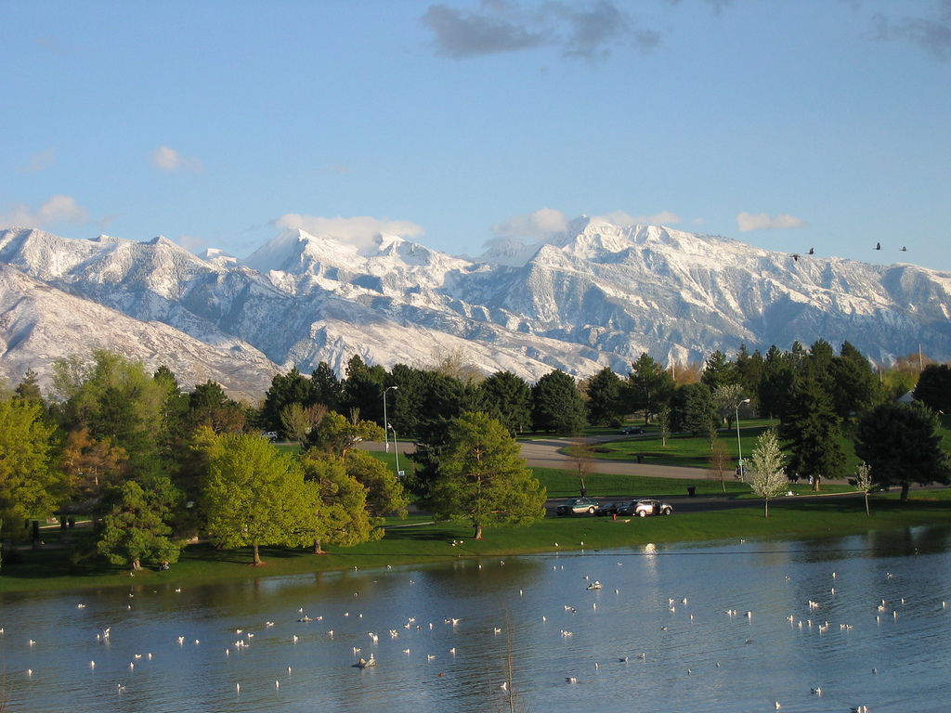

Needs Assessment Results 2012 to 2017

Slide 2

Project Profile
We are comparing two statistically-significant surveys of SLCo residents.
Studies conducted five years apart 2012 & 2017.
Results identify trends in service needs of county residents delivered by parks and recreation.
Prevailing attitudes around revenue and fees and future actions are also examined.
Notes:
2535 usable responses

Slide 3
Age Demographics
2012
2017
Notes:
2535 usable responses

Slide 4
Geographic Demographics
2012
2017

Slide 5
Demographics
2012 vs 2017 Key Takeaways:
Respondents skew slightly older in 2017.
Salt Lake City had a higher response rate in 2017 (+6%).

Slide 6
Park Amenities
Notes:
Traded out horseshoe pit for Walking trails – walking trails took the lead in importance
The next top 3 match the top three in 2012.
Riverton had above standard dev on skate park, fishing pond, disc golf, and both dog parks

Slide 7
Park Amenities
2012 vs 2017 Key Takeaways:
Walking trails (new question) jumps to Rank #1. The rest of the top 5 remain the same.
Notable mover: Fenced off-leash dog parks up 10% as a high priority.
27%
35%
Notes:
Traded out horseshoe pit for Walking trails – walking trails took the lead in importance
The next top 3 match the top three in 2012.
Riverton had above standard dev on skate park, fishing pond, disc golf, and both dog parks

Slide 8
Sports Amenities
Notes:
Tennis court moved up in importance over 2012, the other top 2 remain the same.
Herriman has negative std dev for little baseball, babe ruth, softball, backstop, basketball, volleyball, tennis and golf course
South salt lake has negative std dev for little baseball, babe ruth, softball, backstop, basketball, volleyball, and tennis
Riverton positive std dev for lacrosse, little baseball, babe ruth and softball

Slide 9
Sports Amenities
2012 vs 2017 Key Takeaways:
Tennis Courts are the largest mover from bottom half to Rank #3.
Multi-purpose fields overtake basketball courts as the #1 priority amenity.
New pickleball question scores well (28% high priority).

Slide 10
Recreation Amenities
Notes:
Top three priorities remained the same.

Slide 11
Recreation Amenities
42%
47%
32%
32%
Notes:
Top three priorities remained the same.

Slide 12
Recreation Amenities
47%
42%
42%
23%
Notes:
Top three priorities remained the same.

Slide 13
Youth Recreation Programs
Notes:
Youth athletics moved up in importance rest are in the same approx. order.
5 cities (Draper, Midvale, South Jordan, Herriman, and Murray) has neg std dev on Ice Skate

Slide 14
Youth Recreation Programs
2012 vs 2017 Key Takeaways:
Learn to swim remains highest priority.
Big riser - Youth athletics (+10% high priority)
45%
55%

Slide 15
Adult Recreation Programs
Notes:
Same priority as 2012.

Slide 16
Adult Recreation Programs
2012 vs 2017 Key Takeaways:
All categories in adult recreation remained at the same ranking.
Fitness, continuing education, and organized athletics are the top three priorities of respondents.

Slide 17
Recreation Services and Programs
Notes:
After school programs moved up in importance
Drop in childcare moved up.
Open access computer labs moved down.
Riverton positive dev on daycare, childcare, school programs, school break, tennis lessons, community events and volunteer opportunities.
Community events were negative dev in Draper, Herriman, and Murray but positive in Riverton and Taylorsville.

Slide 18
Recreation Services and Programs
2012 vs 2017 Key Takeaways:
After school programs and drop-in childcare went up as priority services.
Large drop in need of open access to computer labs as a general priority:
64%
45%

Slide 19
Outreach and Communication
How did you learn about SLCo Parks and Recreation?
Notes:
Social media moved from one of the last answers to number one
Newspaper moved down
The rest are about the same.
Rec brochures seem more effective at Magna, Midvale, and South Jordan.

Slide 20
Outreach and Communication
2012 vs 2017 Key Takeaways:
Social media up, Newspapers down.
32%
43%
6%
13%

Slide 21
Future Actions
Notes:
Top 5 priorities are about the same

Slide 22
Future Actions
2012 vs 2017 Key Takeaways:
Park maintenance overtook walking trails for #1 ranking.
Building new trails and maintaining our existing trails both remain in the top five.
Acquiring land for both parks and open space also remain top priorities.
Notes:
Traded out horseshoe pit for Walking trails – walking trails took the lead in importance
The next top 3 match the top three in 2012.
Riverton had above standard dev on skate park, fishing pond, disc golf, and both dog parks

Slide 23
Taxes and User Fees - 2012
Notes:
Question 23 listed nineteen recreation programs and services where Salt Lake County Parks and Recreation uses taxes, user fees, or a combination of taxes and user fees to maintain. None of the programs and services had a majority of respondents who felt they should be maintained only with taxes. The following programs or services had a majority of respondents saying they should be maintained with a combination of taxes and user fees: youth fitness and wellness (57%), programs for teens (56%), youth scholarship programs (52%), senior fitness (52%), before and after school programs (51%), and nature programs/environmental education (51%).
Programs where a majority of respondents felt that user fees should pay for program maintenance included adult organized athletics (77%), adult art, dance, performing arts (77%), indoor space for small events (73%), athletic special events (67%), drop in childcare (64%), adult continuing education (60%), and youth art, dance, and performing arts (52%).
The following programs and services had no majority of respondents saying maintenance should be allocated to user fees, taxes, or a combination of taxes and user fees. Percentages were higher for user fees or combination of user fees and taxes rather than taxes alone for youth athletics, school break programs, community events, open access computer labs, and farmers market. Programs for people with disabilities percentages were higher for taxes or combination of taxes and user fees than for just user fees.

Slide 24
Taxes and User Fees - 2017

Slide 25
Taxes and Fees
2012 vs 2017 Key Takeaways:
Attitudes about taxes and user fees remains relatively unchanged.
Programs for youth and senior education and wellness, as well as programs for the disabled should be more subsidized.
Youth and adult sports should be more fee-based.

Slide 26
Conclusions
We listen to the public and try to meet the needs of all County residents.
Residents want a higher level of operations and maintenance.
Trails are universally popular.
This data allows us to strategically plan our future.

