Slide 1
Pre-Application Webinar: Expanding Affordable Housing Opportunities RFA
Salt Lake County Housing & Community Development
October 24, 2025

Slide 2
Agenda
Introductions of Staff
Purpose of RFA
Funding Overview
Loan Terms and Conditions
Program Information
Eligible Uses of Funds
Timeline
Application Process
Appendix overview
Scoring & Evaluation
Question & Answer

Slide 3
Introductions
Josh Narvaez – Housing Trust Fund Manager
Tallie Viteri – Community Development Manager
Jennier Jimenez – HCD Operations Manager
Tanya Birks – HCD Division Director

Slide 4
Purpose of RFA
The purpose of the RFA is to award one developer that is partnered with a service provider to develop and operate permanent supportive housing units for individuals with high mental health needs in Salt Lake County.

Slide 5
Funding Overview
$1.8 million in CDBG will be dedicated to eligible housing development costs, including acquisition, rehabilitation, or site improvements.
$711,000 in HTF will be available for eligible housing development costs as well as covering the costs of supportive services for the project.
Approximately $2,511,000.00 available in funding

Slide 6
Program Information
Project must meet one of the CDBG's National Objective
  Benefit low and moderate income (LMI) persons
    Area benefit: providing a service or improvement in a residential area where at least 51% of the residents are LMI.
    Limited clientele: providing a service to a specific group of people, such as the elderly, severely disabled, or victims of domestic violence, provided that at least 51% of the group meets the LMI criteria.
    Activities like the acquisition, rehabilitation, or new construction of housing where LMI households will reside.
  Prevention or elimination of slums or blight: activities that address the physical decay of a community. This can include acquiring and redeveloping properties in a slum or blighted area.
  Urgent need: Activities that address serious and immediate threats to public health or safety, such as responding to a natural disaster or a public health crisis.

Slide 7
Program Information
Projects must comply with Davis Bacon wage requirements, Section 3, National Environmental Policy Act, Buy America Build America, and any other requirements as outlined in 24 CFR 570
Be located wholly within Salt Lake County
Demonstrate ability to expend funds between January 1, 2026 – December 31, 2026

Slide 8
Eligible Uses of Funds
24 CFR Part 570.200
Acquisition and site development
  Land or property acquisition for housing development
  Clearance and demolition of blighted structures to prepare site
  Site improvements and infrastructure such as grading, drainage, streets, and utility connections
  Environmental remediation of contaminated site
Rehabilitation and preservation
  Rehabilitation of existing housing to meet code and livability standards
  Accessibility improvements for ADA compliance
  Conversion of nonresidential buildings into affordable housing
CDBG generally does not allow new housing construction except:
  By a Community Based Development Organization (CBDO) under 24 CFR 570.204
Supportive services (HTF funds only)

Slide 9
Timeline
Date | Activity
Tuesday, October 14, 2025 | Applications Available Via Smartsheet. For more information, please visit https://www.saltlakecounty.gov/regional-development/housing-community-development/apply-for-grant-funding/expanding-affordable-housing-opportunities/
Friday, October 24, 2025 | Pre- Application Training Register Here: https://slco.webex.com/weblink/register/r5df2dc0ef0c1e62cd5ec84f7a143335b
Friday, October 31, 2025 | Final Day to Submit Questions https://app.smartsheet.com/b/form/f49bdd1dee1e4dc7b8b4fc3087b4a2ab
Friday, November 7, 2025 | Applications Due Via Smartsheet https://app.smartsheet.com/b/form/4e395ddcddc445858a085194b950d227
November 2025 | Application Reviews with board members/ Citizen Advisory Committee
December 2025 | Final Funding Recommendations Will Be Available
January 2026 | Award Effective Date

Slide 10
Application Process
Appendix A – Application and Project Information
  https://app.smartsheet.com/b/form/4e395ddcddc445858a085194b950d227

Slide 11
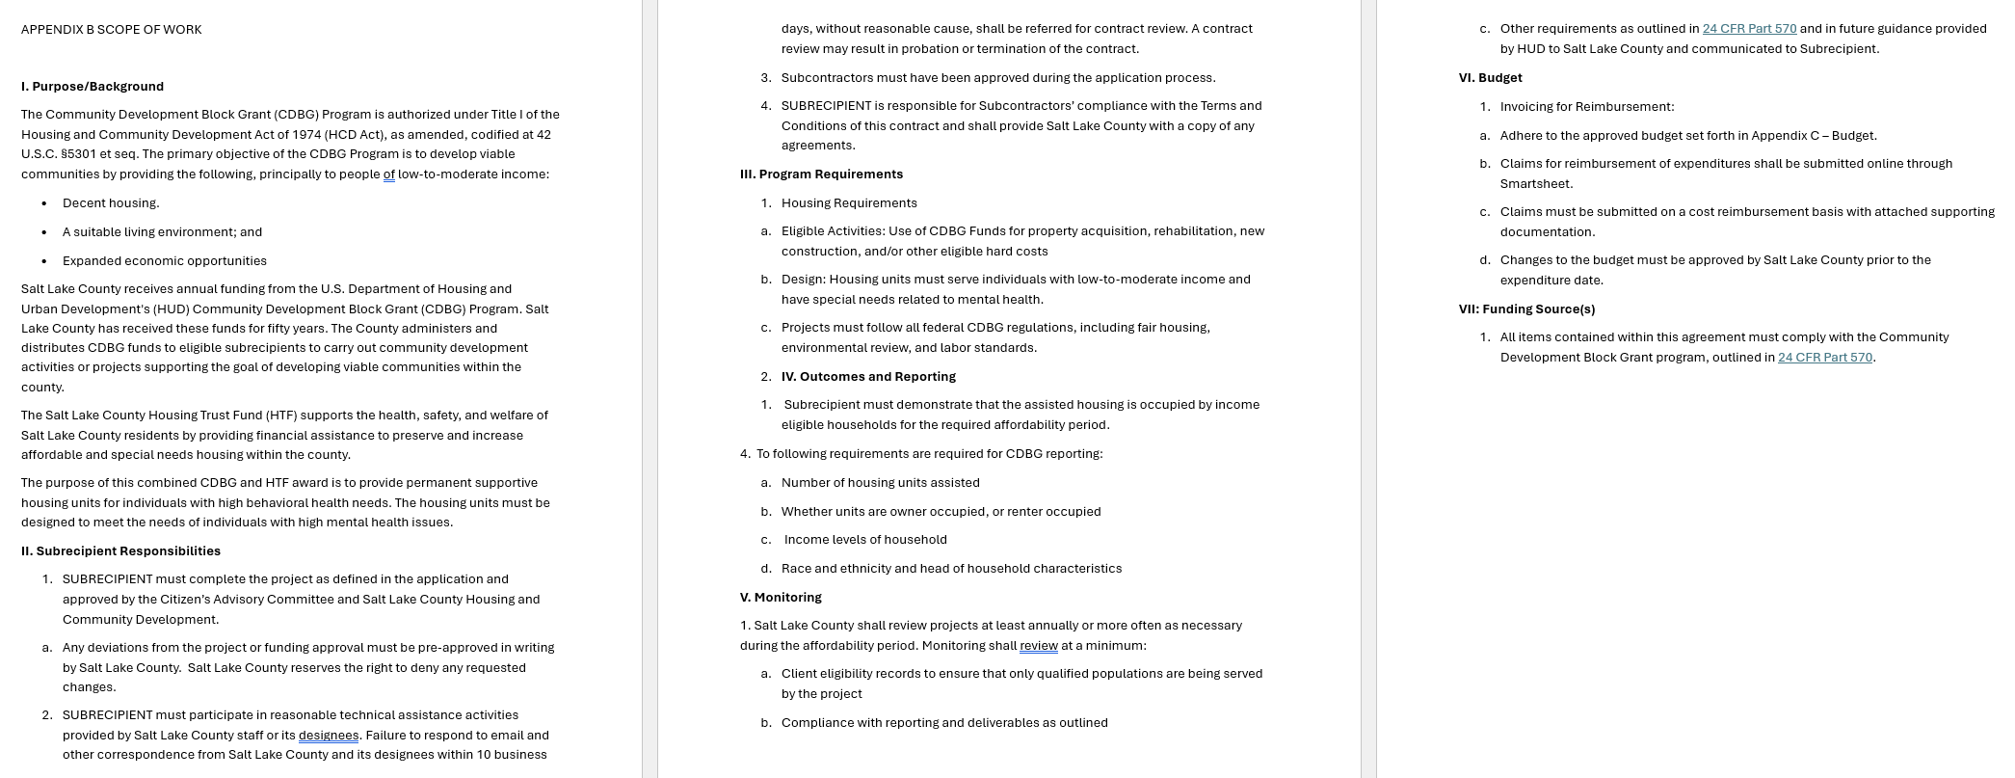
Appendix B

Slide 12
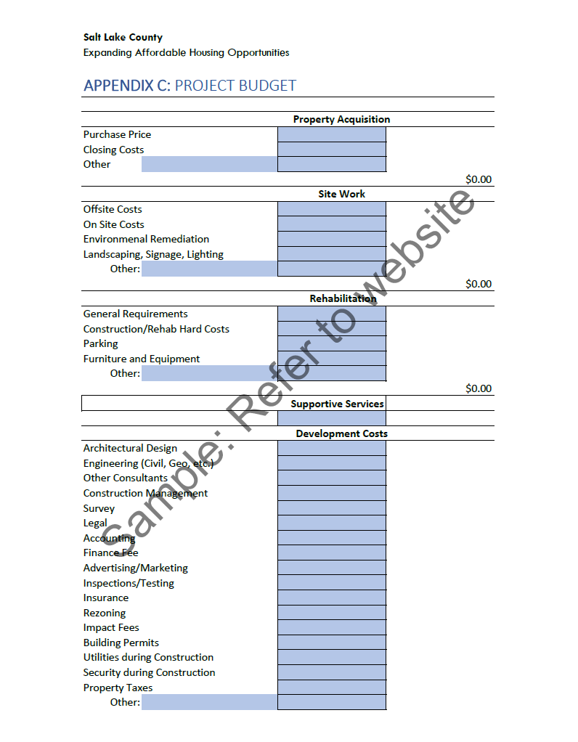
Appendix C

Slide 13
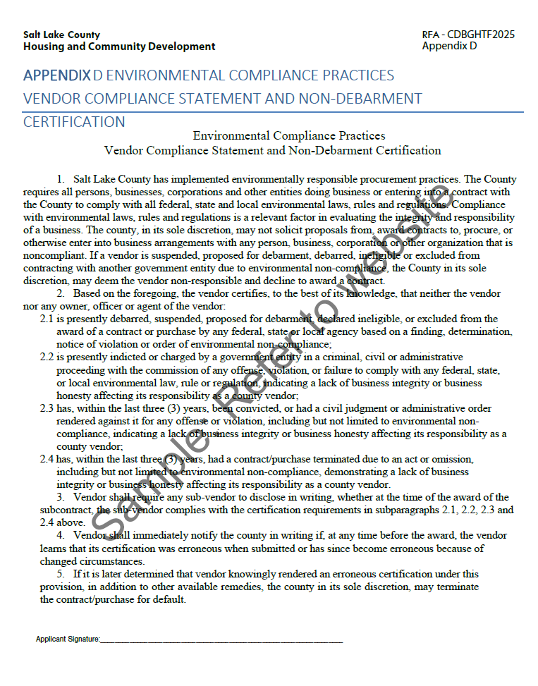
Appendix D

Slide 14
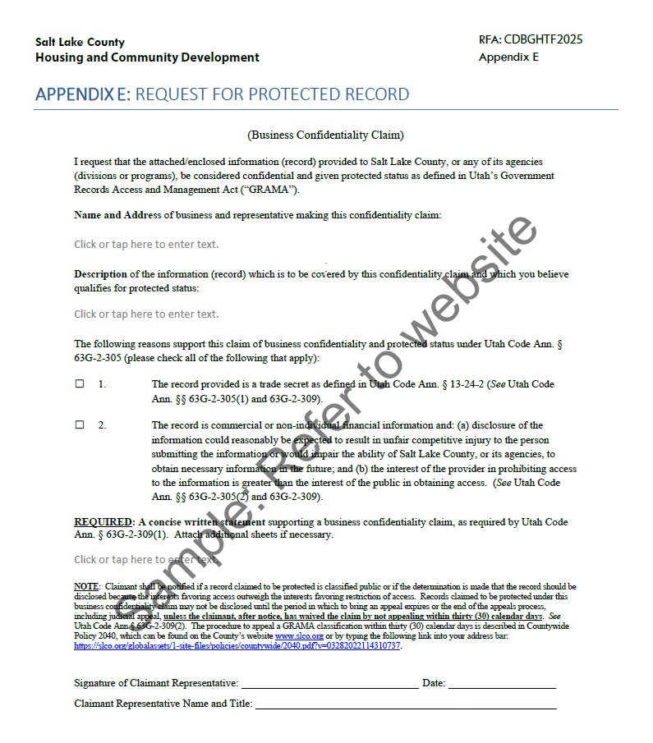
Appendix E

Slide 15
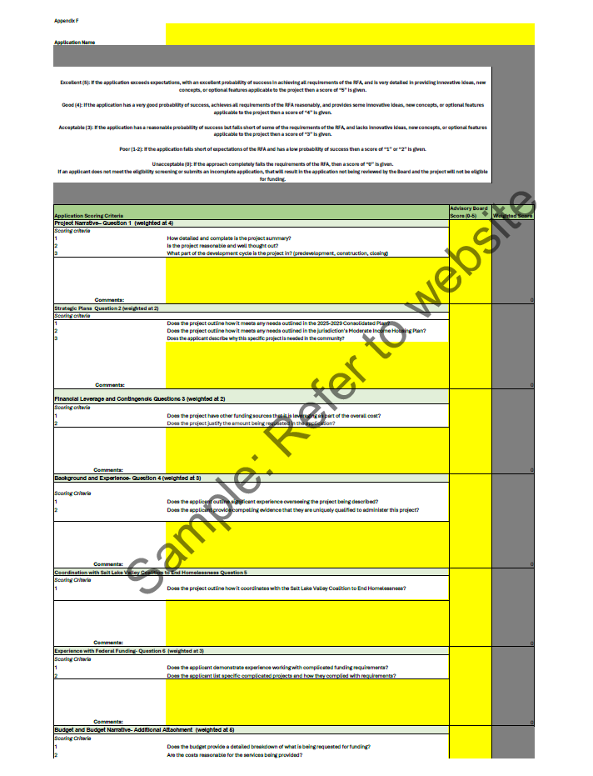
Appendix F

Slide 16
Scoring & Evaluation
Applications will be scored and ranked based on the criteria outlined in the RFA.
Each section is weighted to make the scoring criteria objective.
Final award amounts will be determined on the number of applications and how they meet the RFA priorities.
Evaluation​ | Explanation​
Excellent (5)​ | Application exceeds expectations, with an excellent probability of success in achieving all requirements of the RFA, and is very detailed in providing innovative ideas, new concepts, or optional features applicable to the project. ​
Good (4)​ | Application has a very good probability of success, achieves all requirements of the FRA reasonably, and provides some innovative ideas, new concepts, or optional features applicable to the project. ​
Acceptable (3)​ | Application has a reasonable probability of success but falls short of some of the requirements of the RFA, and lacks innovative ideas, new concepts, or optional features applicable to the project. ​
Poor (1-2)​ | Application falls short of the expectations of the RFA and has a low probability of success. ​
Unacceptable (0)​ | Application completely fails the requirements of the RFA. ​

Slide 17
Question & Answer
Please submit additional questions through Smartsheet on page 6 of the RFA by Friday, October 31st.
https://app.smartsheet.com/b/form/f49bdd1dee1e4dc7b8b4fc3087b4a2ab

Slide 18
Thank you for your interest in the Expanding Affordable Housing Opportunities RFA!

