Slide 1





Jail Resource
Reentry Program
(JRRP)

Slide 2

JRRP provides a short-term location to wait for information, services, and referrals
Help navigate the transition from jail back into the community by offering access to services and support they may need to stabilize, stay healthy and regain self-sufficiency.
Reduce disruptive behavior in the community after release.
Decrease the likelihood that the person will re-offend and return to jail.
Notes:
Lesson descriptions should be brief.

Slide 3
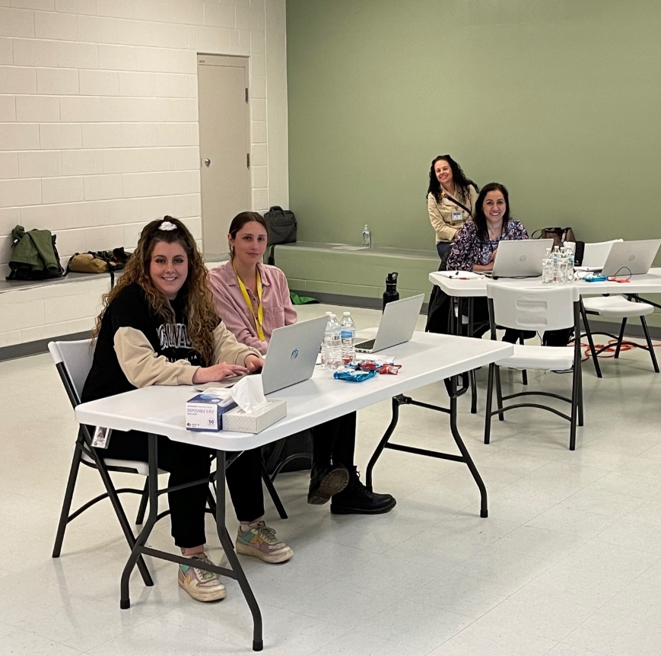
The Soft Opening
April 1, 2022
Began helping clients who were exiting the jail, provided hands-on staff training and enhanced relationships with stakeholders.
We were able to identify barriers and establish pathways to solutions.
Notes:
Wait times for detox (hours/days), women's DV shelter (1 week), treatment (days/weeks)

Slide 4




Top Client
Legal and Supervision
Needs
Medicaid
Housing

Slide 6

Shelter Survey Results

Slide 7
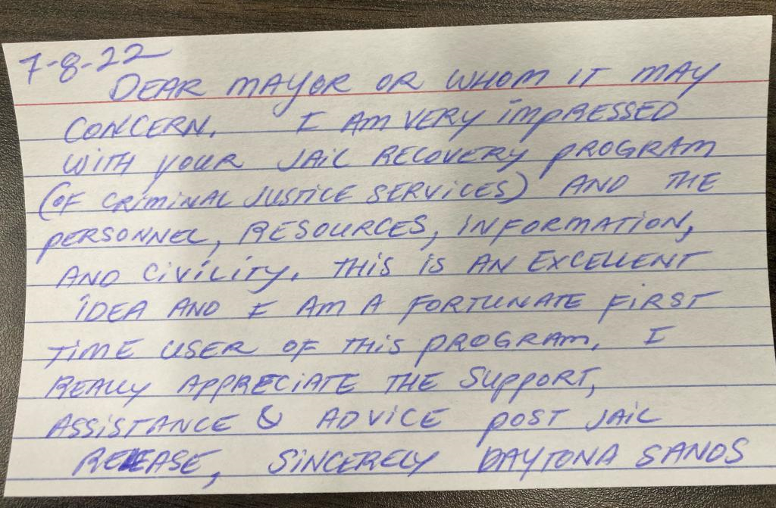


One of Many Wins

Slide 8

Project Budget Three Years: $5,307,740
Funding: Grant, County & ARPA
  $1,000,000 Bureau of Justice Grant: Innovations in Re-entry Initiative Building System Capacity and Testing Re-entry Strategies
      Planning
      Implementation
      Evaluation
  $1,000,000 County Match
  $3,307,740 ARPA
Project Budget and Funding

Slide 9
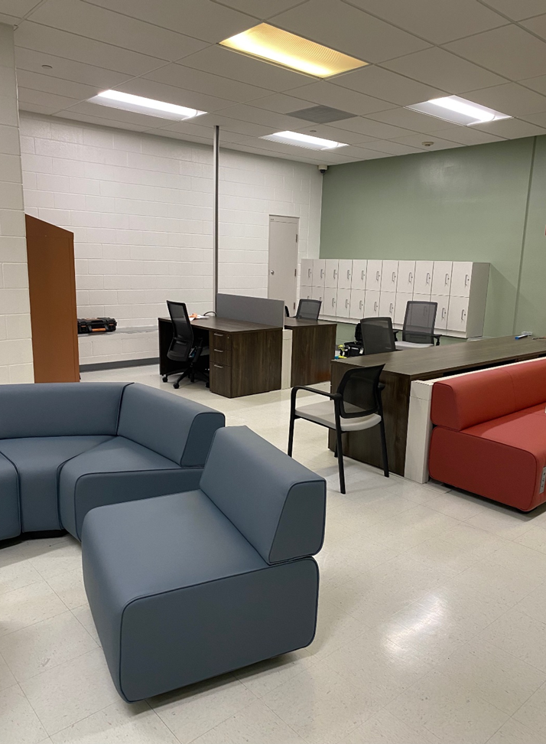
Moving Forward
Hire and train
Continue recruitment with all agencies
Use Data
Provide services based on data and identified needs
Enhance Program
Consistent training on community resources
Expand to seven days a week 7 am – 11 pm
Look at reduction in recidivism
Enhance warm-hand off services with treatment providers
Increase safe short-term housing options
Direct communication with community supervision
Reduce the length of time between charges

Slide 10

JRRP Data Update
May 1 – July 18, 2022

Slide 11
Data Notes
An “Interaction” is defined as a Smartsheet entry
An individual only handed water or who charges their phone will NOT count
“Qualifying Releases” are releases through the JRRP, not into someone else’s custody.

Slide 12
Data Notes
Qualifying Releases
These were the top release types that could have JRRP interactions
This counts only the last release type
Release Type | Releases
Order Release to Pretrial Services | 1162
Overcrowding Release | 843
Time Served | 539
Other Order to Release | 460
Pre-File Release | 240

Slide 13
General Statistics
468 JRRP Interactions between May 1 and July 18

Slide 14
General Statistics
468 JRRP Interactions between May 1 and July 18
Expanded Hours

Slide 15
Example Case: Sean
JRRP Interaction on 6/9
  Referral to Medicaid
  Housing and Transportation Information
Released on Time Served after serving a sentence
Waited in the JRRP an hour before the center was open

Slide 16
Example Case: Sean
JRRP Interaction on 6/9
  Referral to Medicaid
  Housing and Transportation Information
Released on Time Served after serving a sentence
Waited in the JRRP an hour before the center was open
One of two Time Served releases to get a Medicaid referral so far

Slide 17
Interactions by Selected Release Types
Some release types have more JRRP Interactions than others
Table only counts releases during JRRP Hours
Release Type | JRRP Interactions | All Releases | Percent of Releases
Order Release to Pretrial Services | 133 | 430 | 31%
Overcrowding Release | 69 | 240 | 29%
Other Order to Release | 59 | 203 | 29%
Pre-File Release | 43 | 118 | 36%
Time Served | 4 | 42 | 10%
Grand Total | 422 | 1428 | 30%

Slide 18
Interactions by Selected Release Types
Some release types have more JRRP Interactions than others
Table only counts releases during JRRP Hours
Release Type | JRRP Interactions | All Releases | Percent of Releases
Order Release to Pretrial Services | 133 | 430 | 31%
Overcrowding Release | 69 | 240 | 29%
Other Order to Release | 59 | 203 | 29%
Pre-File Release | 43 | 118 | 36%
Time Served | 4 | 42 | 10%
Grand Total | 422 | 1428 | 30%

Slide 19
JRRP Demographics
Individuals with JRRP interactions mirror the demographics of all jail releases
Charge severity and charge type are very similar between both groups
Exception is a much shorter average length of stay
Demographic | JRRP | All Qualifying Releases
Female | 26% | 24%
Male | 74% | 76%
Average Age | 37.4 | 37.0
% Felony Charges | 47% | 41%
Drug Charges | 37% | 37%
Property Charges | 35% | 31%
Length of Stay | 4.9 days | 26.5 days

Slide 20
Interactions by Service Provided
The top services provided are information about court and supervision
This may be a function of release types

Slide 21
When do qualifying releases happen?
From May 1 to July 18:

Slide 22
When do qualifying releases happen?
From May 1 to July 18:
Large Chunk of Time Served Releases

Slide 23
Interactions by Service Provided
The top services provided are information about court and supervision
Release Type | Provided Court Information? | Provided Supervision Information? | Coordinated Referral to Medicaid/TAM?
Order Release to Pretrial Services | 43% | 61% | 23%
Overcrowding Release | 70% | 16% | 19%
Other Order to Release | 44% | 31% | 24%
Pre-File Release | 74% | 28% | 28%
Time Served | 0% | 25% | 50%

Slide 24
Outcomes to be Tracked – BJA and ARPA
Recidivism
  Reduce number of future bookings
  Increase time between bookings
  Reduce number of FTAs/warrants
Community service connectivity
  Warm hand-offs to treatment
  Medicaid referrals
  Term of engagement in services
Initial data reporting to occur 6-12 months after program start.

Slide 25
Conclusion and Next Steps
JRRP is still very new, with many planned resources and data still to come
Continue to explore data and evaluate system and resource gaps more thoroughly
Recommendation: Establish work group to examine release times
  Representation from agencies to include: CJS, Sheriff, LDA, DA, and Others?

Slide 26
Thank you!

