Slide 1
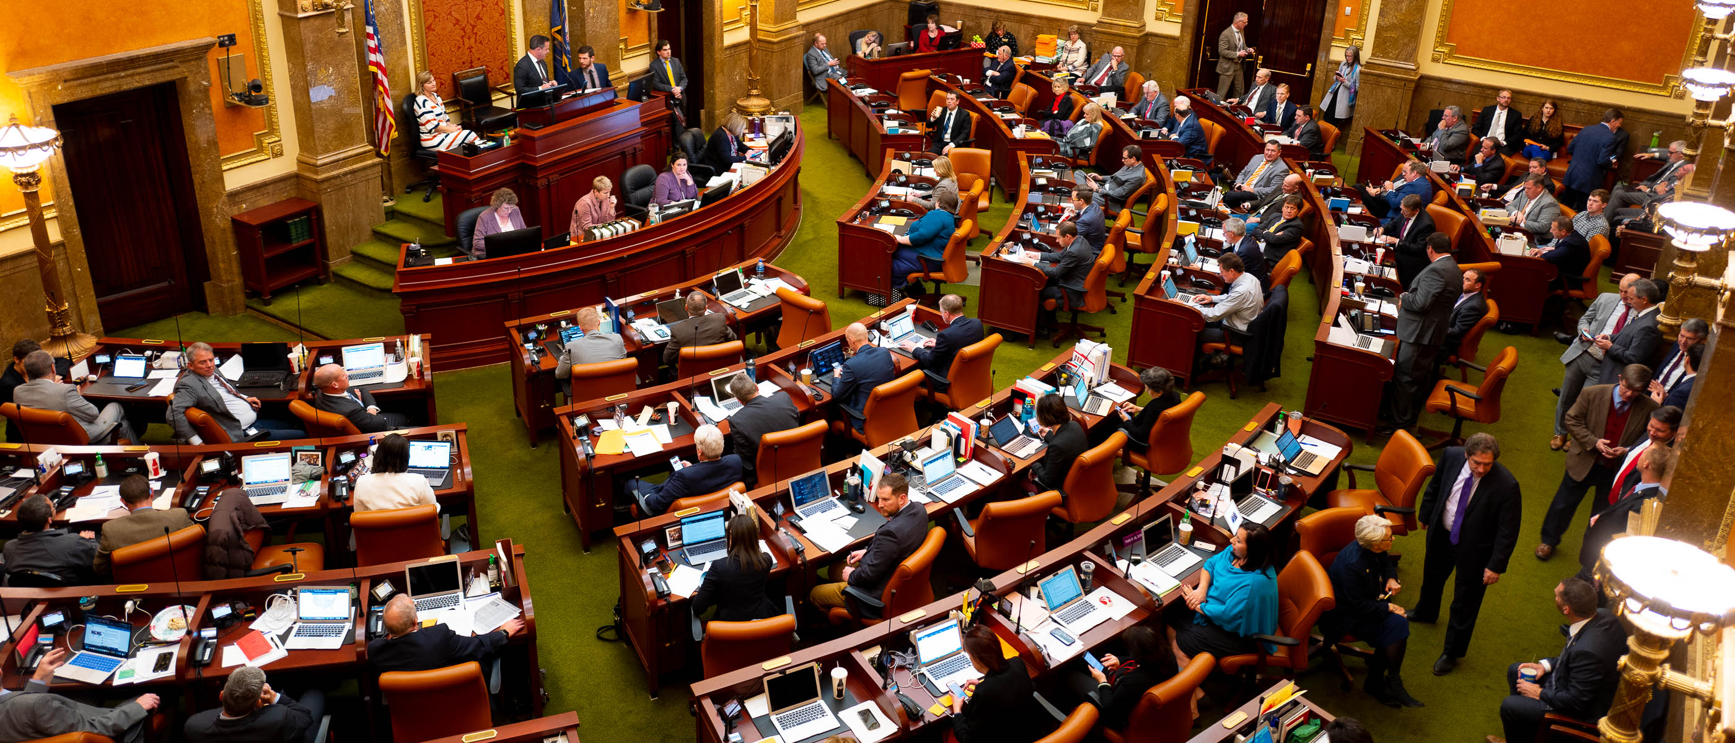

Legislative Update
Juvenile Justice
Pamela Vickrey
Executive Director Utah Juvenile Defender Attorneys
Notes:
774 bills filed
502 bills passed

Slide 2
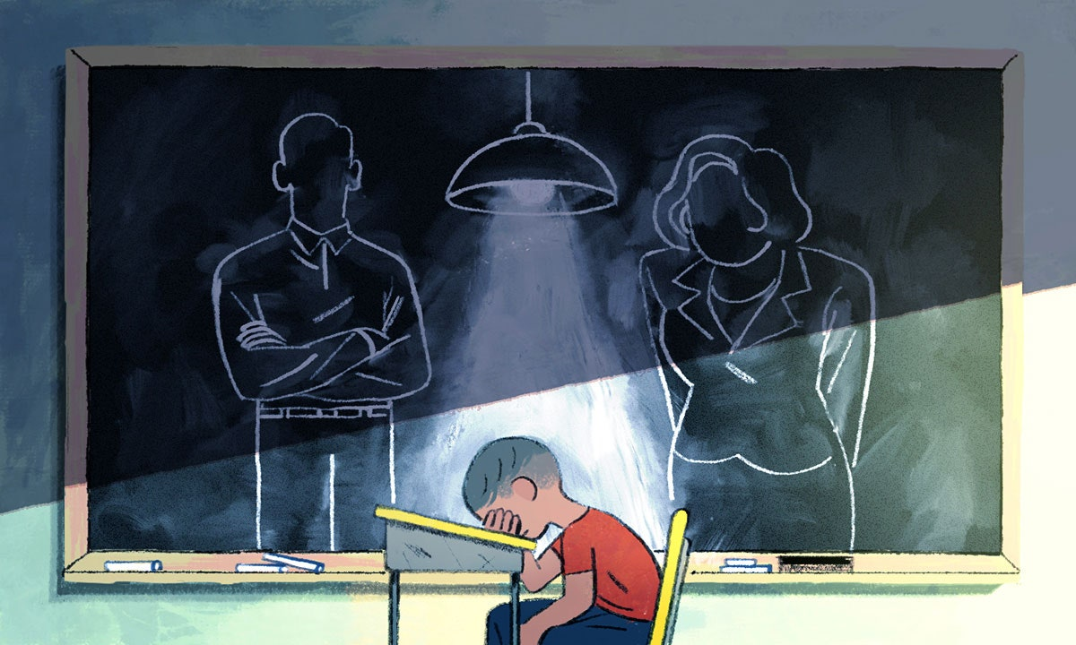
HB 158 – Juvenile Interrogation Amendments
Requires a child (under 18) subject to interrogation:
Be informed of constitutional rights
Have a parent or friendly adult present for interrogation
Parent/friendly adult consent to interrogation
Notes:
Rep. Judkins

Slide 3
Juvenile Interrogation Amendments Cont.
Exceptions to parent/friendly adults:
Emancipation
Misrepresented age and reliance on misrepresentation
Reasonable efforts to contact parent and no contact within 1 hour

Slide 4
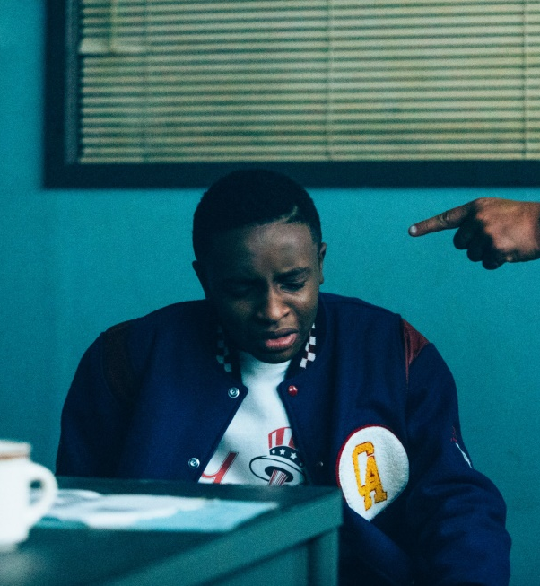
Juvenile Interrogation Amendments Cont.
If a minor (25 and under) is interrogated in a youth facility or a child (under 18) in a youth facility/jail must have:
Meaningful opportunity to consult with counsel
Counsel present for interrogation

Slide 5


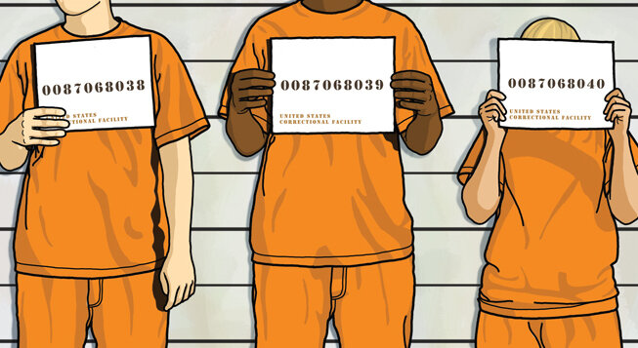
HB410 – Passed but not Enrolled
Requires that a youth that is being tried as an adult be held in a juvenile detention facility and if they are committed to prison, they be housed in a juvenile facility until the age of 21, unless a safety or security risk exists. Current law is 18
Clean up
Ensures that the presumptive Length of Stay guidelines do not apply for a secure care commitment or parole for any offense that involves loss of life
Youth aging out of JJS with a sex specific offense must register as a sex offender. When we created an extended jurisdiction option last year, we did not adjust for those youth that age out under this extension (25).
Notes:
Rep. Snow

Slide 6


HB 67 – Juvenile Sentencing Amendments
Clarifies that a secure care commitment does not end when a criminal sentence is imposed
Allows a jail or prison sentence to be served in secure care
Notes:
Rep. Hall

Slide 7
SB 50 – Juvenile Offender Penalty Amendments
For individuals convicted in district court of sex offense committed as juvenile (except transfer):
No registration
Presumptive probation unless facts stated on the record why incarceration necessary
Able to expunge conviction
Does not apply to individuals convicted of sex offense after age 18
Notes:
Sen. Thatcher

Slide 8
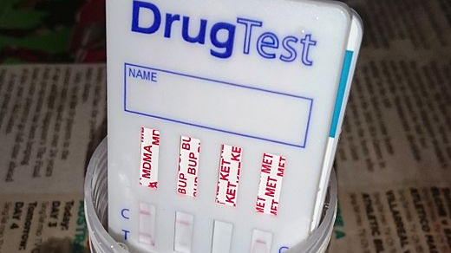
HB 73 – Drug Testing Amendments
Judge, DCFS, or GAL may not require an individual to drug test by means of hair or fingernail tests
Notes:
Rep. Watkins

Slide 9


HB279
Enables youth attending school in JJS Secure Care Facilities to qualify for concurrent enrollment credits
Creates the Dixie State Higher Education for Incarcerated Youth Program
Provides an option for incarcerated youth to participate in higher education courses through virtual learning through DSU
Creates a pathway for incarcerated youth to receive certificates, Associates, or Bachelor’s degrees through DSU
Provides on going funding to DSU to administer the program and fund youth
https://www.sltrib.com/news/education/2021/02/16/incarcerated-youths-utah/
Notes:
Rep Snow

Slide 10

HB345
Goal
To make mandatory what is included in training
Schools with SROs must collect data
Prohibit SROS in elementary schools
Outcome
Adds to training school personnel
Adds to training:
Developing and supporting successful relationships with students
Legal parameters of searching and questioning students on school property
Notes:
Rep. Hollins

Slide 11
SB 90 – Child Welfare Amendments
Clarifies training needed for case worker
Prohibits court from receiving unsubstantiated DCFS reports in divorce/custody proceeding
Creates requirements when near fatality occurs
Cannot expunge adjudication for neglect, abuse, dependency or termination
Cannot seal juvenile records on MIS/LIS unless substantiated or stipulation
Notes:
Sen. Harper

Slide 12
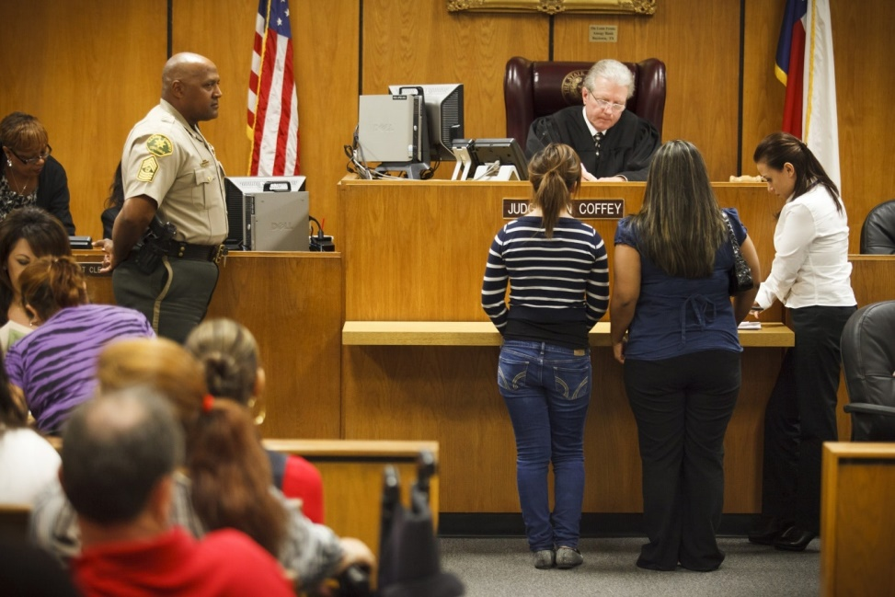
HB 285 – Juvenile Recodification
Recodifies juvenile code
Section 80 created
Notes:
Rep. Snow
Link to comparison between old and new statute
https://le.utah.gov/lrgc/Recodification/ComparisonOldNew.pdf

Slide 13
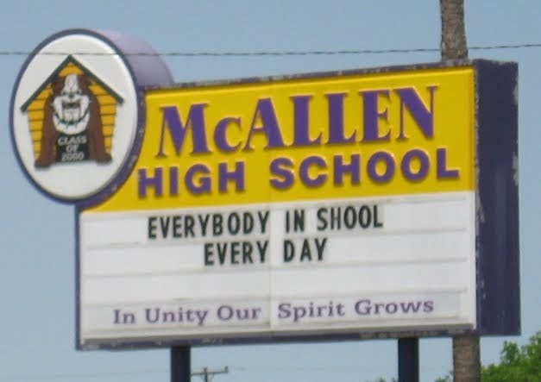
SB 219 – Truancy Enforcement Moratorium
Suspends truancy/comp ed criminalization until June 1, 2022
Notes:
Sen. McCay

Slide 14
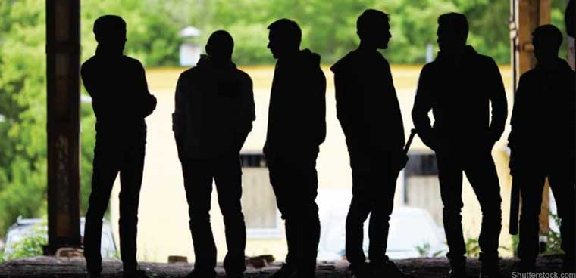
SB 51 – Gang/Group Enhancement Amendments
Increases number of people from 2 to 3 that can be considered a group
Changes offenses that can be enhanced
Changes penalty for some enhanced offenses
Notes:
Senator Thatcher

