Slide 1
- BREAK -

Slide 2

2023 NEW HIRE BENEFITS ORIENTATION
Benefits begin on day 1 of eligibility !!!!!!!
You have 31 days from your date of hire to enroll

Slide 3
HR Benefits
Benefits Team Contacts:
Team Members:
email: benefits@slco.org
phone: 385-468-0580
website: benefits.slco.org
Jessica Dahl – Benefits Specialist
Penny Sherman – Benefits Specialist
Tina Thomson – Benefit Analyst
Travis Firzlaff – Benefit Analyst
Elaine Schurter-Sullivan – Manager
County Employee Benefits Guide: 2023-benefits-guide---as-of-10.28.2022.pdf

Slide 4









WELLNESS
On-Site Clinic
Healthy Lifestyles
EAP
Leave
INCOME PROTECTION
Short Term Disability
Long Term Disability
Life Insurance
Hospital Indemnity
Accident/Illness
HEALTH
Medical & Pharmacy
Dental
Vision
SAVINGS PLANS
Retirement
URS Plan Options
Health Savings Account
Flexible Spending Accounts
– Health, Daycare & Limited
DISCOUNTS
& PERKS
Voluntary Benefits
On-Site Daycare

Slide 5
County employee benefit eligibility
SPOUSE CHILDREN ADULT DESIGNEE
LEGAL SPOUSE
CHILDREN
  UP TO AGE 26 – single, married or in school
  IF DISABLED – Qualifying Disability determined by the Health Plan
ADULT DESIGNEE
  SIGNIFICANT OTHER TO WHOM YOU ARE NOT MARRIED OR A FAMILY MEMBER WITH WHOM YOU SHARE A RELATIONSHIP
  NEITHER OF YOU CAN BE MARRIED TO SOMEONE ELSE
  BOTH MUST BE OVER AGE 18
  SHARE JOINT EXPENSES
    MUST PROVIDE DOCUMENTATION
    https://slco.org/human-resources/benefits/insurance-benefits/

Slide 6
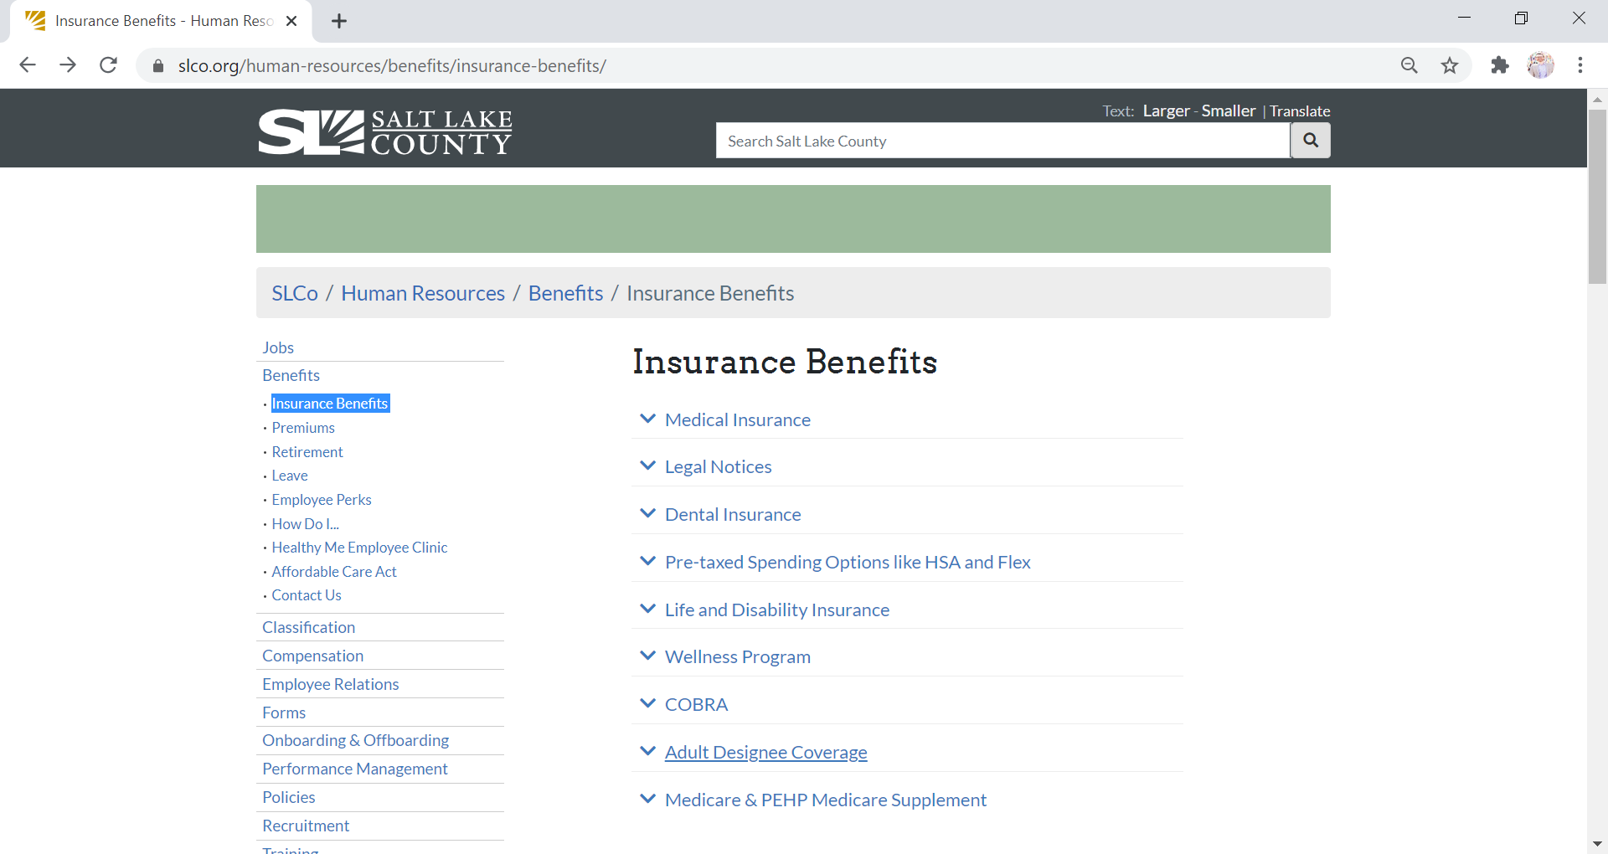
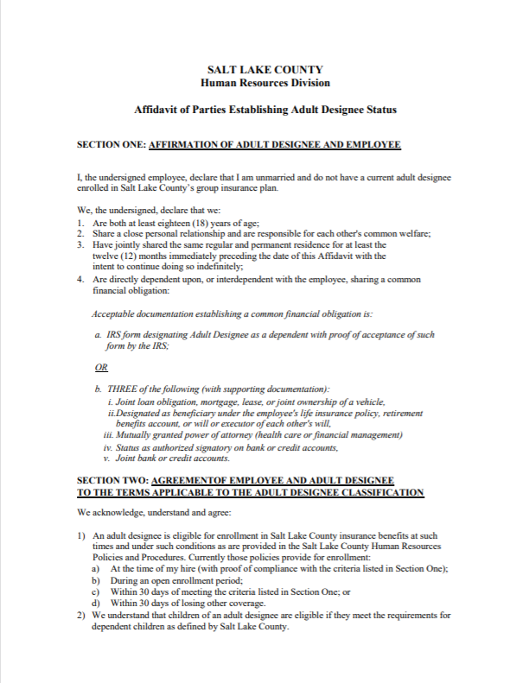
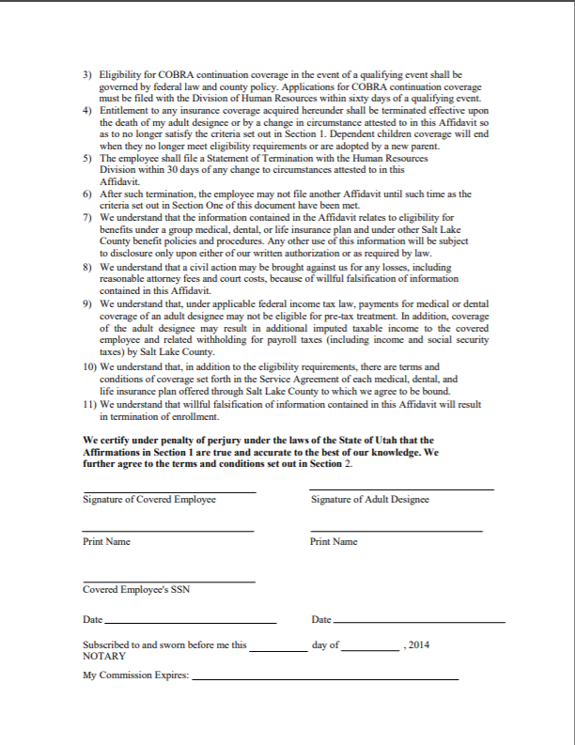
County employee benefit eligibility
ADULT DESIGNEE
    https://slco.org/human-resources/benefits/insurance-benefits/

Slide 7








Medical Plans - Network Options
SelectHealth MED NETWORK
SUMMIT NETWORK
Both hospitals below are In Network under either plan

Slide 8
Medical Plans – Network Options
The Networks pay the same
Both have IN and OUT of Network benefits
Preventative Services Paid 100%
Other services apply to deductible first
Vision Services paid under Medical plan
Mental Health is a covered benefits
SelectHealth Med Network
Also in Idaho, Nevada
Limited Network outside these areas
SelectHealth.org 801-442-5038
Summit Network
Out-of-state coverage through Multi-Plan Network
PEHP.org 801-366-7555

Slide 9
Medical Plans – Coverage Options
Salt Lake County offers 2 plans to employees
Type 1: High Deductible Health Plan (HDHP)
Type 2: Preferred Provider Organization Traditional (PPO)
Available on the PEHP and SelectHealth Network
  Covered benefits mirror on each plan
Choose your Network
  What hospitals and providers are best for you
Choose which type of plan
  What will work best for your situation/family
*** If you do not ENROLL or WAIVE within 31 days, you will be automatically enrolled in Select Health HDHP employee only coverage ***

Slide 10
Medical Plan – High Deductible Health Plan (HDHP)
Out of pocket costs for care
Premium - Cost per paycheck
Deductible: You Family
500 $2,000 $4,000
Coinsurance You County
10% 90%
Out-of-Pocket Max: You Family
$3,500 $7,000
Full Time Part Time
Employee Employee
$0 $86.77
Family Family
$0 $249.23
NOT Health Eligible
**Premiums due back to eligibility date, once you enroll. Will take current amount plus ½ until caught up
HSA Eligible, Limited FSA Eligible
NOT Medical FSA Eligible

Slide 11

Health Savings Account (HSA)
HDHP Plan
The What
The Why
The How
County Contribution:
*pro-rated based on hire date
Single: $600
Family: $1,200
Total Yearly Contribution:
The maximum:
$3,850 (single)
$7,750 (family)
Employees 55+ can add up to an additional $1000
Set aside pre-tax dollars
Use for Medical, Dental, Rx, Vision
No rollover maximum
Funds 100% yours if you leave employment
You can invest funds after balance reaches $2000
Employee Contributions
County Contribution (lump sum)
Healthy Lifestyles:
*you can earn up to
Single : $275
Employee + Spouse $550
Fidelity
www.netbenefits.com
800-544-3716

Slide 12

Health Savings Account (HSA)
HDHP Plan

Slide 13
Medical Plan – PPO (Traditional)
Out of pocket costs for care
Premium - Cost per paycheck
Deductible: You Family
500 $500 $1,000
Coinsurance You County
20% 80%
Out-of-Pocket Max: You Family
$3,500 $7,000
Full Time:
Employee Only: $60.92
Employee +1: $134.31
Employee +2 or more: $180.92
Part Time:
Employee Only: $125.54
Employee +1: $276.00
Employee +2 or more: $361.38
**Premiums due back to eligibility date, once you enroll. Will take current amount plus ½ until caught up
Medical FSA Eligible, NOT HSA Eligible

Slide 14

Flexible Spending Account (FSA)
Additional Spending Accounts
(PPO Plan)
Pre-Tax contributions from paycheck
Use for Medical, Dental, Rx, Vision
Full Balance Available January 1st
Annual Maximum Contribution: $3,050
$610 Annual Carry-Over Limit
Forfeit if leave county
Limited Flex (HDHP only):
Dental & Vision Only
Annual Maximum: $3,050
$610 rollover allowed
Dependent Care Flex:
Covers Dependent Care costs up
to age 13
Annual maximum: $5,000
No rollover
**Keep your receipts**
http://www.asiflex.com/
800-659-3035

Slide 15

Flexible Spending Account (FSA)
**Keep your receipts**
http://www.asiflex.com/
800-659-3035

Slide 16
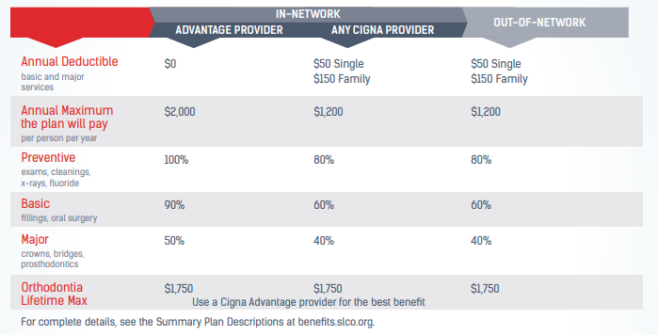
Cigna Dental DPPO

Slide 17
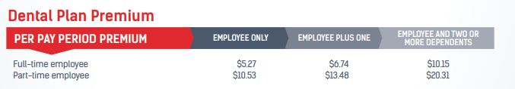

Cigna Dental DPPO
➢ For help with questions and locating a network dentist or specialist,
call Cigna at 800-244-6224
*** If you do not ENROLL or WAIVE within 31 days, you will be automatically enrolled in Cigna employee only coverage ***

Slide 18

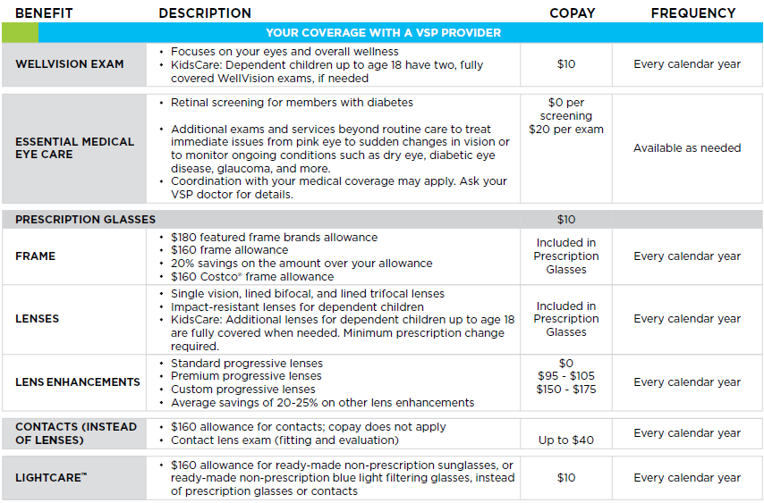
VSP Vision Care
Premiums:
Member Only - $3.58
Member + 1 - $7.15
Member + 2 or more - $11.51

Slide 19

Life Insurance
Employer Paid Life Insurance
Automatic $25,000 Term Life policy at no cost (*up to age 70)
Employee Paid Life Insurance
Can enroll for up to $200,000 of additional coverage with no underwriting if you enroll within the first 31 days of eligibility
*** Can enroll in additional Life Insurance coverage at anytime, but will be
subject to evidence of insurability outside of initial eligibility period ***

Slide 20

Life Insurance
Employer Paid Life Insurance
Life Insurance: Spouse & Dependents
Automatic $25,000 Term Life policy at no cost (*up to age 70)
Can enroll up to $50,000 spouse insurance without underwriting within 31 days eligibility
Dependent coverage applies to unmarried dependents
under age 26
  Cost covers all dependents
  all dependents covered at same level
Employee Paid Life Insurance
Can enroll for up to $200,000 of additional coverage with no underwriting if you enroll within the first 31 days of eligibility
*** Can enroll in additional Life Insurance coverage at anytime, but will be
subject to evidence of insurability outside of initial eligibility period ***

Slide 21
Accidental Death and Dismemberment (AD&D)
Accident Weekly Indemnity
Accident Medical Expense
Provides benefits for:
Death
Loss of use of limbs, speech, hearing or eyesight
Due to an accident
Individual and Family plan options:
$25,000 to $250,000
  Spouse 50% of your coverage amount if no other dependents, otherwise 40% of yours
  Dependent children 15% of our coverage amount, if no spouse increases to 20% of yours
If you enroll in AD&D, may also purchase:
Accident Weekly Indemnity
  employee only coverage
  maximum weekly amount salary based
Accident Medical Expense
  employee only coverage
  provides up to $2,500 to help cover medical expenses due to an accident, not job related
*** Refer to benefits guide for more information and Master Policy for complete terms and conditions at www.pehp.org

Slide 22

Long-term Disability Insurance
Long-Term Disability Insurance
Employer paid benefit
Automatically enrolled
90 Day Elimination Period
For all merit, time limited and elected benefit eligible EE’s working more than 20 hrs/week
Your responsibility to apply when you need it
Benefits Team can help

Slide 23


Short-Term Disability Insurance
Definition of Disability
  Receiving care and treatment due to sickness, pregnancy or accidental illness (generally speaking)
  Coverage can help protect your income when you are unable to work due to illness or injury
  All benefit eligible employees; premium based on salary
  66 2/3% of your pre-disability weekly earnings; plan max of $2500
  Begin on 15th day after onset of illness or injury
  Maximum duration is 11 weeks of disability

Slide 24
Guide Page 41
Covered Benefits:
Network Attorney fees for a variety covered matters such as:
Wills and Estate Planning
Bankruptcy
Small Claims Court
Tax Audit and more
Access to more than 14,000 attorneys
Available in person or by phone
Covered Dependents:
Spouse or Partner
Children up to age 26
UltimateAdvisor PlusTM plan includes Identity Theft Protection

Slide 25
HealthyMe Clinic
Healthy Lifestyles
WELLNESS
Leave
Employee Assistance Program
(EAP)

Slide 26
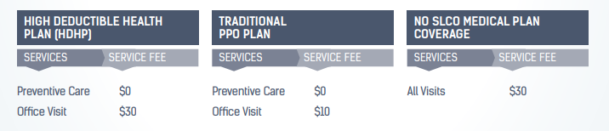

HealthyMe Clinic
You and your eligible dependents have access to exceptional, confidential, and low-cost medical and mental health care at the HealthyMe Clinic.

Slide 27

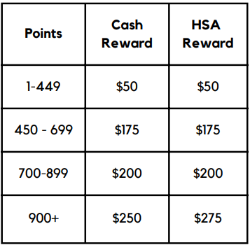
Healthy Lifestyles is an incentive-based Employee Wellness Program, promoting healthy behaviors and lifestyles, ensuring a healthier work environment and lowering overall healthcare costs
Points earned January 1st through October 31st

Slide 28


Blunovus CARE
Emotional Support Helpline and Resource Center
Unlimited services for you & your loved ones
CARE Center:
Anonymous & Unlimited Situational Support
Text or call 24/7 and access a live person to listen
Expert Courses available on demand, online
Wellness Coaching & Weekly Mental Health Text Tips
Download App and enter
Registration Code: SL COUNTY
Contact Us:
Toll-Free: (385) 205-6789
Website: www.blunovus.com

Slide 29
Blunovus EAP Support
EAP Counseling & Therapy Services:
6 Free Counseling Visits; 15 for First Responders
  Anxiety, depression, relationships, stress
  Short-term counseling with referrals for long-term
Financial & Legal Consultation
Wellness Coaching & Weekly Text Tips
Personal Support
Download App and enter
Registration Code: SL COUNTY
Contact Us:
Toll-Free: (385) 205-6789
Website: www.blunovus.com

Slide 30
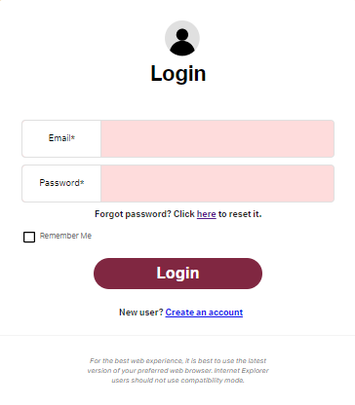
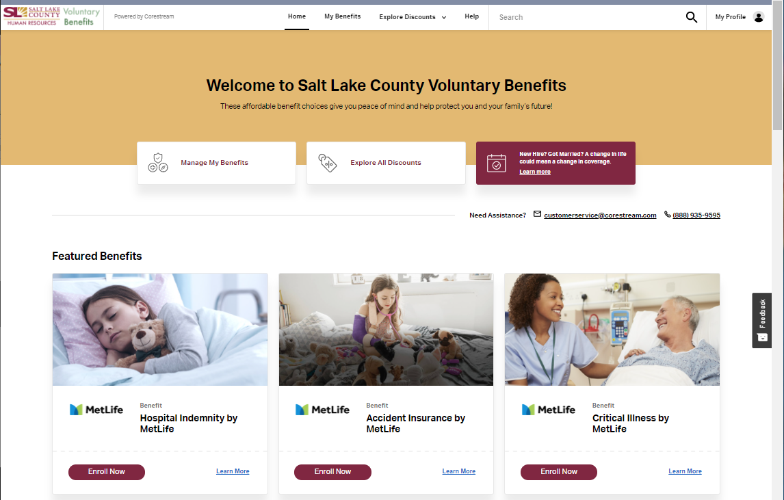
Voluntary Benefits
Enroll at slcountyvoluntarybenefits.com

Slide 31
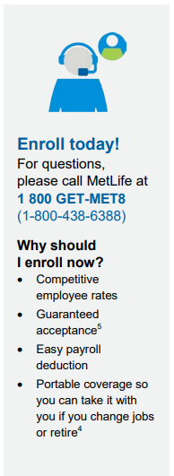
Additional Insurance Options
Critical Illness Insurance
Accident Insurance
Hospital Indemnity Insurance
Enroll at slcountyvoluntarybenefits.com

Slide 32

Voluntary Benefits
Enroll at slcountyvoluntarybenefits.com
Nationwide Pet
Health Insurance
Pick your coverage – pick your price
50% or 70% reimbursement
Get a no obligation quote: 877-738-7874

Slide 33


Voluntary Benefits
Student Loan Refinancing & Loan Repayment
Student Loan Financial Education via consultations, webinars
Public Service Loan Forgiveness Membership
Contact Us:
Toll-Free: 844-GRADFIN
Website: www.GradFin.com
Enroll at slcountyvoluntarybenefits.com

Slide 34

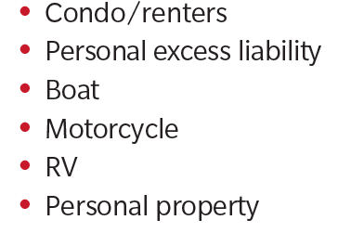
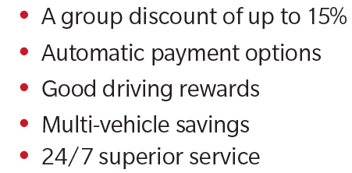
Voluntary Benefits
Farmers Home
& Auto Insurance
Call 844-300-7021
Mention discount code: A20

Slide 35

Voluntary Benefits
Norton LifeLock Benefit Solutions
Device Security
Online Privacy
Identity Protection
Home & Family Monitoring

Slide 36

Voluntary Benefits
On-Site Day Care
Creative Learning Academy
Please Visit clautah.net for more information
Call 385-468-7133 for more information
about the Government Center location
2001 S State St. S1-400
Call 385-468-7751 for more information
about the downtown District Attorney location
35 E 500 S

Slide 37

Tuition Reimbursement
Tuition Reimbursement
Salt Lake County financially supports the educational pursuits of its employees through the Tuition Reimbursement Program.
For more information: https://www.slco.org/human-resources/employee-university/tuition-reimbursement/

Slide 38
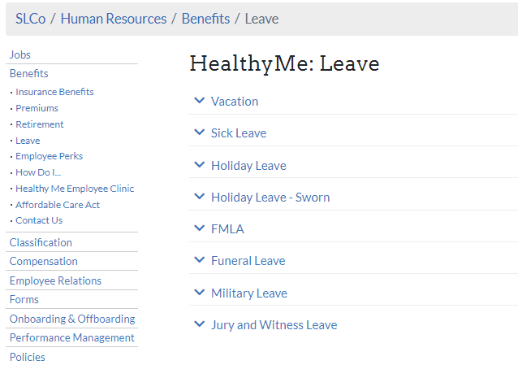
Leave Policy
HR Policy 4-200 Leave Practices
Vacation
Sick
Holiday
Parental
Funeral
Military
Jury and Witness
Other Benefit policies can be found under
Section 4 on slco.org/human-resources
Refer to policies found on slco.org/human-resources and https://www.slco.org/human-resources/benefits/leave/

Slide 39
Steps to Enroll
Required:
Log in to PeopleSoft at: https://pshcm.slcounty.org/my.policy
Health Savings Account (HSA)
Flex Spending Accounts (FSA)
  Medical, Limited, Daycare
Enroll or waive elections for:
Medical
Dental
Vision
Legal
Short-Term Disability
Complete within 31 days of hire

Slide 40
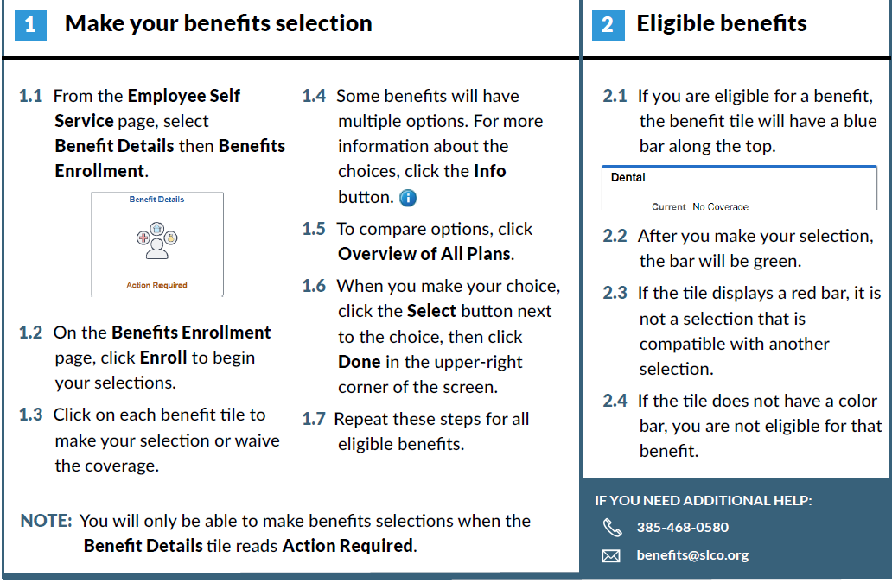
PeopleSoft Fluid Enrollment

Slide 41
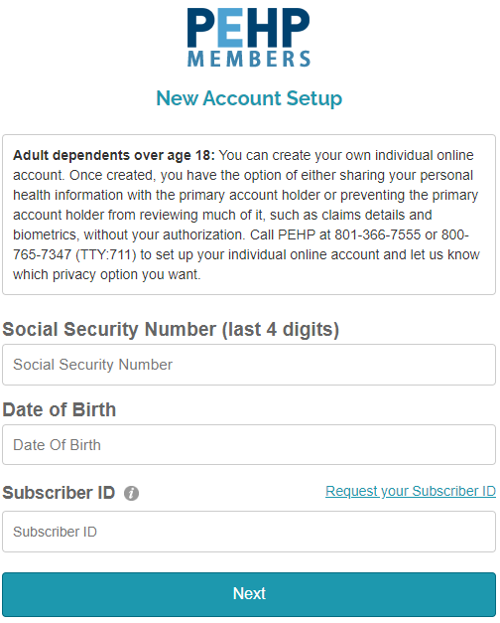
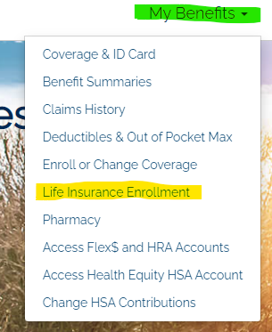

Steps to Enroll
Life Insurance
Elect life insurance with no underwriting at https://www.pehp.org
Your Subscriber ID number begins with 1741 and was provided on the PEHP letter emailed to you
Set up your account and save login information to make updates in the future
Name your beneficiaries for life insurance at pehp.org (highly encouraged)
*** Can enroll in additional Life Insurance coverage at anytime, but will be
subject to evidence of insurability outside of initial eligibility period ***

Slide 42

Retirement with URS
Received letter via email with account number
  Starts with ‘W’
Login to www.urs.org
Assign beneficiaries
Elect optional savings plans
*** Employees in Tier 2 have 1 year within their hire date to select a retirement plan ***

Slide 43
WELLNESS
On-Site Clinic
Healthy Lifestyles
EAP
Leave
INCOME PROTECTION
Short Term Disability
Long Term Disability
Life Insurance
Hospital Indemnity
Accident/Illness
HEALTH
Medical & Pharmacy
Dental
Vision
SAVINGS PLANS
Retirement
URS Plan Options
Health Savings Account
Flexible Spending Accounts
– Health, Daycare & Limited
DISCOUNTS
& PERKS
Voluntary Benefits
On-site Daycare

Slide 44
Welcome to Salt Lake County!
Benefits Orientation 2023
Benefits team contacts:
email: benefits@slco.org
phone: 385-468-0580
website: benefits.slco.org
*** Remember: You have 31 days from your date of hire
to enroll in or waive your benefits ***

Slide 45
- BREAK -

