Slide 1

2026 New Employee Benefits Orientation
Benefits offered to employees working 20+ hours
Benefits begin on FIRST DAY of eligible status
You have 31-DAYS from that date to enroll

Slide 2
HR Benefits
Benefits Team Contacts
Team Members:
Jessica Dahl – Benefits Specialist
Penny Sherman – Benefits Specialist
Tina Thomson – Benefit Analyst
Travis Firzlaff – Benefit Analyst
Elaine Schurter-Sullivan – Manager
Phone: 385-468-0580
benefits@saltlakecounty.gov
County Benefits Website: https://www.saltlakecounty.gov/human-resources/benefits/

Slide 3









WELLNESS On-Site Clinic Employee Wellness EAP Leave
INCOME PROTECTION
Short Term Disability
Long Term Disability
Life Insurance
Hospital Indemnity
Accident/Illness
HEALTH
Medical & Pharmacy
Dental
Vision
SAVINGS PLANS
Retirement
URS Plan Options
Health Savings Account
Flexible Spending Accounts
– Health, Daycare & Limited
VOLUNTARY PLANS, PERKS & DISCOUNTS
Accident, Critical Illness & Hospital
Legal and ID Theft Tuition Reimbursement and more

Slide 4
County Employee Benefit Eligibility
Legal Spouse
Dependent Children
Up to age 26, regardless of marriage or student status
Over age 26 if disabled (requires approval of the Health Plan)
Adult Designee
Domestic Partner/Significant Other to whom you are not married OR a family member with whom you share a financial relationship
Neither of you may be married to someone else
Both must be over age 18
Must share joint expenses/financial obligations and provide required affidavit and supporting documentation

Slide 5








Medical Plans - Network Options
Select Health MED & VALUE NETWORKS
SUMMIT NETWORK
Both hospitals below are In Network under either plan

Slide 6
Medical Plans – Network Options
The Networks pay the same
Both have IN and OUT of Network benefits
Preventative Services Paid 100%
Other services apply to deductible first
Vision Services paid under Medical plan
Mental Health is a covered benefits
Select Health Med & Value Networks
Also in Idaho, Nevada
Limited Network outside these areas
Call 801-442-5038 or visit http://www.selecthealth.org/
Summit Network
Out-of-state coverage through Multi-Plan Network
Call 801-366-7555 or visit http://www.pehp.org/

Slide 7
Medical Plans – Coverage Options
Salt Lake County offers 2 plans to employees
High-Deductible Health Plan (HDHP)
Traditional |Preferred Provider Organization (PPO)
Choice between PEHP and SelectHealth networks | Coverage is mirrored on each plan
Choose your Network
What hospitals and providers are best for you
Choose which type of plan
What will work best for your situation/family
If you do not ENROLL or WAIVE within 31 days, you will be automatically enrolled in
Select Health HDHP employee-only coverage

Slide 8
2026 Medical Plan – HDHP High Deductible Health Plan
Out of pocket costs for care
Premium – Cost per paycheck
Deductible: Individual Family
500 $2,500 $5,000
Coinsurance Individual County
10% 90%
Out-of-Pocket Max: Individual Family
$4,000 $8,000
Full Time
Employee Only:
$0
Family:
$0
Part Time
Employee Only:
$96.53
Family:
$277.26
Once enrolled, premiums are due back to eligibility date. Payroll deductions will take current premiums plus half of arrears amount until caught up
Health Savings Account (HSA) and Limited Purpose FSA Eligible
May use traditional FSA (only) by choice or if ineligible for an HSA but not both

Slide 9

Health Savings Account (HSA)
HDHP Plan
Benefits
Contributions
Limits
Set aside pre-tax dollars
Use for Medical, Dental, Rx, Vision
No rollover maximum
Funds 100% yours if you leave employment
You can invest funds
Employee Payroll Contributions
County Contribution (lump sum):
*pro-rated based on hire date
Single: $600
Family: $1,200
Employee Wellness Program:
*you can earn up to:
Single: $275
Employee + Spouse: $550
2026 Max Contributions:
Single: $4400
Family: $8750
Employees 55+ can add up to an additional $1000
Fidelity
www.netbenefits.com
800-544-3716

Slide 10
2026 Medical Plan – PPO (Traditional)
Out of pocket costs for care
Premium – Cost per paycheck
Deductible: Individual Family
500 $1,000 $2,000
Coinsurance: Individual County
20% 80%
Out-of-Pocket Max: Individual Family
$4,000 $8,000
Full Time:
Employee Only: $74.27
Employee+1: $163.13
Employee+2 or more: $219.77
Part Time:
Employee Only: $148.54
Employee+1: $326.26
Employee+2 or more: $439.55
Once you enroll, premiums are due back to eligibility date. Payroll deductions will take current premiums plus half of arrears until caught up
Medical FSA Eligible. Ineligible for HSA or Limited Purpose FSA

Slide 11


Flexible Spending Account (FSA)
Additional Spending Accounts
Medical FSA
Pre-Tax contributions from paycheck
Use for Medical, Dental, Rx, Vision
Full Balance Available January 1st
2026 Annual Maximum: $3,400
$680 rollover limit
Forfeit funds at year-end (over rollover) or if you leave SLCo (balance)
Limited FSA (Must have HDHP and HSA):
Dental & Vision Only
2026 Annual Maximum: $3,400
$680 rollover limit
Dependent Care FSA
Covers Dependent Care costs up to age 13
2026 Annual maximum: $7,500
No rollover
Receipts are required to file claims
www.asiflex.com or 800-659-3035

Slide 12
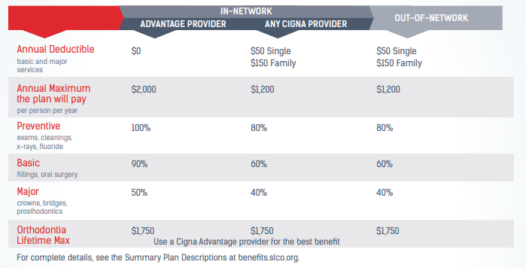
Cigna Dental DPPO

Slide 13

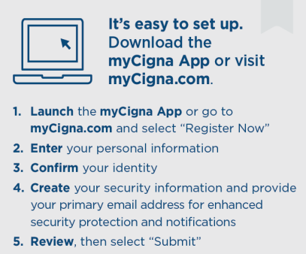
Cigna Dental DPPO
Premium – Cost per paycheck
Full Time:
Employee Only: $5.27
Employee+1: $6.74
Employee+2 or more: $10.15
Part Time:
Employee Only: $10.53
Employee+1: $13.48
Employee+2 or more: $20.31
For questions or assistance locating an in-network dentist or specialist, call Cigna at
800-244-6224

Slide 14

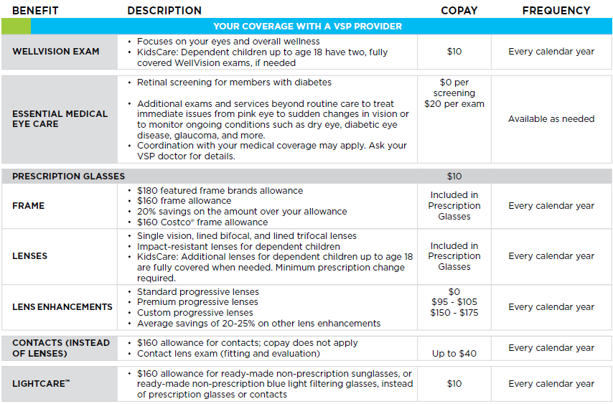
VSP Vision Care
Premiums:
Member Only - $3.30
Member + 1 - $6.60
Member + 2 or more - $10.62

Slide 15
Short Term Disability
AD&D
Long-Term Disability
Life Insurance
INCOME PROTECTION

Slide 16

Life Insurance
Employer Paid Life Insurance
Automatic $50,000 Term Life policy at no cost
Employee Paid Life Insurance
Up to $300,000 of coverage without underwriting within the first 31 days of eligibility
Underwriting required after 31-days or for amounts of $325,000 - $500,000
Coverage is available in $25,000 increments
Coverage max of $500,000* (*benefits reduce at age 70, 75)
Rates are age banded
Assign Beneficiaries in PeopleSoft
Primary and Secondary options
May assign one or more people as Primary (or Secondary) or provide a Trust designation
Website: https://www.standard.com/
Phone: 800-628-8600

Slide 17
Life Insurance
Spouse & Dependents
Up to $50,000 of spouse coverage without underwriting within the first 31 days of eligibility
Underwriting required after 31-days or for amounts of $75,000 - $500,000
Coverage is available in $25,000 increments
Coverage max of $500,000* (*benefits reduce at age 70, 75)
Rates are age banded
Up to $15,000 of dependent coverage without underwriting anytime
Applies to unmarried dependents under age 26
One charge covers all eligible dependents at the same level
Coverage is available in $5,000 increments
Dependent Life rate: $.096 per $1000
Website: https://www.standard.com/
Phone: 800-628-8600

Slide 18
Accidental Death & Dismemberment (AD&D)
Individual and Family plan options:
$25,000 to $250,000
Coverage is available in $25,000 increments
Family Benefits paid based on employee’s elected coverage
Spouse only: 50% of coverage
Dependent Child only: 20 % of coverage
Spouse and Child(ren): 40% for spouse, 15% for each child
Provides benefits for:
Death or loss of use of limb, speech, hearing or eyesight
Due to an accident
Employee Only Rate per $1000: $0.02
Family Rate per $1000: $0.03
Website: https://www.standard.com/
Phone: 800-628-8600

Slide 19

Short-Term Disability Insurance
Income protection when you are unable to work due to illness or injury
Pays 66.67% of your pre-disability weekly salary; plan max of $3000 weekly
14 day waiting period; benefit payment begins on 15th day after onset of illness or injury
Must use accrued PTO/sick leave during waiting period
Maximum benefit duration is 11 weeks
Bi-weekly premium based on salary
Waiting period is extended to 60 days during first 12 months of coverage if not elected during initial 31-day eligibility period
Website: https://www.standard.com/
Phone: 800-628-8600

Slide 20

Long-term Disability Insurance
Employer paid benefit; automatic enrollment
90 Day Elimination Period
For all merit, elected, appointed and time limited benefit eligible employees working 20+ hours/week
Your responsibility to apply when you need it
Benefits Team can help
Website: https://www.standard.com/
Phone: 800-628-8600

Slide 21
Employee Assistance Program (EAP)
Leave Benefits
Employee Wellness Program
HealthyMe Onsite Medical Clinic
WELLNESS BENEFITS

Slide 22
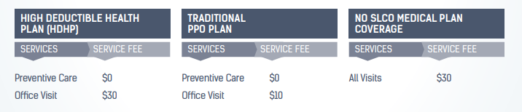

HealthyMe Clinic
You and your eligible dependents have access to exceptional, confidential, and low-cost
medical and mental health care at the HealthyMe Clinic.
**Appointment Only – No Walk-Ins**

Slide 23


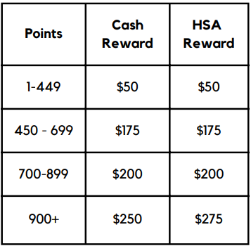
Employee Wellness is an incentive-based program promoting healthy behaviors and lifestyles, ensuring a healthier work environment and lowering overall healthcare costs
Points earned January 1st through October 31st
Website: https://www.saltlakecounty.gov/employee-wellness/
Email: employeewellness@saltlakecounty.gov
Phone: (385) 468-4062

Slide 24

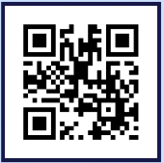

VEST EAP
Emotional Support Helpline and Resource Center
Unlimited services for you & your loved ones
CARE Center:
Anonymous & Unlimited Situational Support
Text or call 24/7 and access a live person to listen
Expert Courses available on demand, online
Wellness Coaching & Weekly Mental Health Text Tips
Download App and enter
Registration Code: SL COUNTY
Contact Us:
Toll-Free: (385) 205-6789
Website: www.blunovus.com

Slide 25
VEST EAP Support
EAP Counseling & Therapy Services:
6 Free Counseling Visits; 15 for First Responders
Anxiety, depression, relationships, stress
Short-term counseling with referrals for long-term
Wellness Coaching & Weekly Text Tips
Personal Support
No out-of-pocket cost to you
Download App and enter
Registration Code: SL COUNTY
Contact Us:
Toll-Free: (385) 205-6789
Website: www.blunovus.com

Slide 26

Leave Policy HR Policy 4-200 Leave Practices
Vacation
Sick
Holiday
Personal Preference Day
Jury and Witness
Military
Funeral
Miscarriage and Still Birth Bereavement
Parental
Human Resource Policies, Section 4: Benefits https://slco.org/human-resources/policies/human-resources-policies/

Slide 27
Home & Auto Discount
Tuition & Service Awards
Daycare, Recreation & Commuter Discounts
Voluntary Health Programs
Legal &
ID Theft Protection
VOLUNTARY PLANS, PERKS & DISCOUNTS

Slide 28


Voya Accident Coverage
Provides a pre-determined payment for specific injuries and treatments
Benefits are yours to use for any purpose
Coverage is guaranteed issue
Benefits are portable if you terminate or retire
Includes a $50 wellness benefit per person
Coverage | Low Plan Biweekly | High Plan Biweekly
Employee | $3.66 | $6.92
Employee + Spouse | $5.49 | $10.38
Employee + Children | $7.00 | $13.20
Family | $8.84 | $16.66

Slide 29

Voya Critical Illness Coverage
Provides a lump-sum benefit if diagnosed with a covered illness or condition
Payouts of $15,000 or $30,000 per incident
Benefits are yours to use for any purpose
Coverage is guaranteed issue to all family members
Benefits are portable at termination or retirement
Includes a $100 wellness benefit per person
Rates based on coverage and employee age

Slide 30

Voya Hospital Coverage
Pays a fixed daily benefit for covered hospital stays
Daily benefit of $100 or $200 to choose from
Benefits are yours to use for any purpose
Coverage is guaranteed issue
Benefits are portable if you terminate or retire
Includes a $50/$100 wellness benefit per person
Coverage | Low Plan Biweekly | High Plan Biweekly
Employee | $3.49 | $6.89
Employee + Spouse | $5.29 | $10.62
Employee + Children | $6.92 | $13.92
Family | $8.72 | $17.64

Slide 31


AURA Identity Theft & Fraud Protection
Financial Fraud Protection for monitoring credit, asset titles and financial accounts, one-tap credit lock, etc.
Alerts to threats to personal information, online accounts, social media, etc.
Tools to ensure privacy and protect devices from malware & viruses, secure public WiFi, etc.
Inclusive family plans cover unlimited dependents and up to 10 adults
24/7 Customer support and App management tools
$5 Million ID theft insurance policy per adult
Employee only coverage - $3.90
Employee + 1 or more - $6.44

Slide 32


LegalShield Legal Services
Direct access to a dedicated provider law firm
Unlimited advice and consultation, such as:
Document review and preparation
Will preparation
Debt collection assistance
Divorce (up to 30 hours)
Biweekly cost of $8.75
Covers Employee, Spouse or Domestic Partner, Children to age 26
Consultation available adult children (+26) living at home or parents

Slide 33

MetLife Pet Insurance
Competitive rates and family plans (multi-pet policies)
Variety of deductible & reimbursement options
Healthy pet incentives & preventive care available
Cover all vet-recommended medications, surgeries and treatments
Pre-existing coverage when switching pet insurance
Easy-to-use mobile app an 24/7 live vet chat
Prices vary based on pet’s age, breed, and number of pets covered
Get a quote by calling 1-800-GETMET8
or visit http://www.metlife.com/getpetquote

Slide 34

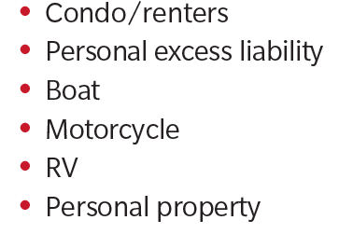
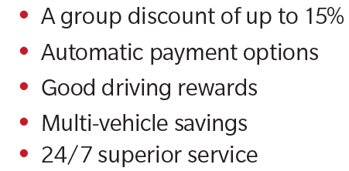
Home & Auto Insurance
Farmers Insurance
Call 844-300-7021
Mention discount code: A20
Enroll at http://slcountyvoluntarybenefits.com/

Slide 35

Tuition Reimbursement
Salt Lake County financially supports the educational pursuits of its employees through the Tuition Reimbursement Program.
Managed by Cynthia Carrington:
(385) 468-0576 or CCarrington@saltlakecounty.gov
Eligibility determined in HR Policy 6-300
Website: https://slco.org/human-resources/learning--development/tuition-reimbursement/

Slide 36

Onsite Daycare
Onsite location at new County Campus, Midvale UT
Services provided by La Petite Academy*
Programs for Infant through Pre-K
Locations throughout the valley
County employees receive a 10% tuition discount at all locations
Call 385-900-7425 for info
*Enrollment at all locations based on space availability

Slide 37
Fitness Center | Recreation Centers
All-County recreation pass available to employees
Provides access to the Government Center fitness center (South Building) and all SLCo Recreation Centers
Passes are $15 per month
Family members may be added for an additional fee
Call 385-468-1789 for more info or visit the Parks & Recreation webpage

Slide 38
Trip Reduction Program
SLCo offers subsidized trip-reduction programs such as
Transit passes
Van pools serving Davis, Salt Lake, Tooele, Utah and Weber counties
Priority parking for carpools
Benefits are available to merit, full or part-time, and temporary employees with EINs
For questions or to apply, email TRP@saltlakecounty.gov or call (385) 468-7070.

Slide 39
Service Awards & Recognition
Salt Lake County values the contributions made by all employees
Service awards are first issued on the 5th anniversary and every 5-years thereafter
Awards received from the 10th anniversary onward include a gift of your choice or cash

Slide 40
Steps for Enrollment
Log into your PeopleSoft self-service portal at: https://pshcm.slcounty.org/
Enroll or waive elections for:
Medical
Dental
Vision
Health Savings Account (HSA)
Flex Spending Accounts (FSA)
Medical, Limited, Daycare
Life Insurance
Supplemental, Spouse, Dependent Life
Accidental Death & Dismemberment (AD&D)
Short-Term Disability
Voluntary Plans
Voya plans, LegalShield, Aura ID Theft, etc.
Supporting documentation is required for any dependent enrollment; have these documents ready for upload when making your elections:
Marriage License
Birth Certificate
Adoption or Guardianship Court Order
SL County Affidavit and all supporting documents for Adult Designee enrollment
Complete within 31 days of hire
**Designate beneficiaries on Life Insurance policies**

Slide 41
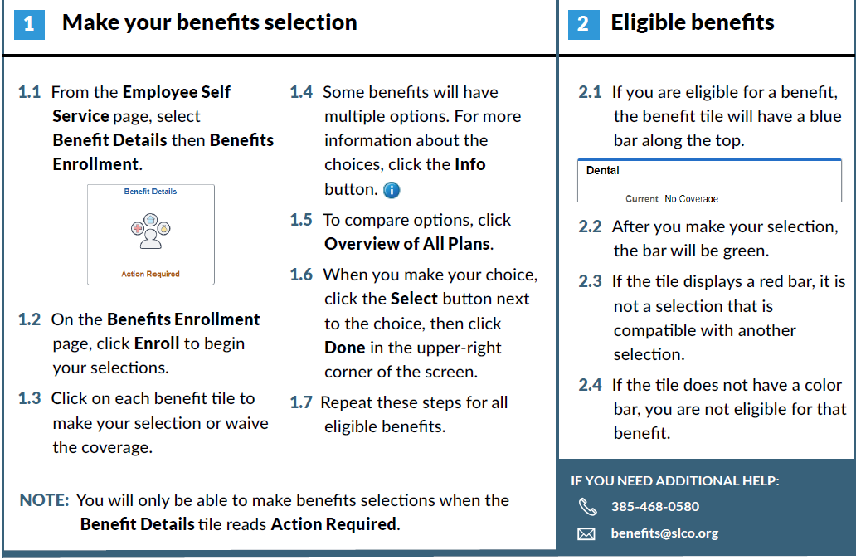
PeopleSoft Fluid Enrollment

Slide 42

Retirement with URS
Certification letter via county email with account number
Account number begins with ‘W’
Visit http://www.urs.org/
Create user portal
Assign beneficiaries
Elect optional savings plans
**Employees in Tier 2 have ONE year within their hire date to select a retirement plan**

Slide 43
WELLNESS On-Site Clinic Employee Wellness EAP Leave
INCOME PROTECTION
Short Term Disability
Long Term Disability
Life Insurance
Hospital Indemnity
Accident/Illness
HEALTH
Medical & Pharmacy
Dental
Vision
SAVINGS PLANS
Retirement
URS Plan Options
Health Savings Account
Flexible Spending Accounts
– Health, Daycare & Limited
VOLUNTARY PLANS, PERKS & DISCOUNTS
Accident, Critical Illness & Hospital
Legal and ID Theft Tuition Reimbursement and more

Slide 44
Welcome to Salt Lake County!
Benefits Orientation 2026
Benefits team contacts:
phone: (385) 468-0580
email: benefits@saltlakecounty.gov
website: https://www.saltlakecounty.gov/human-resources/benefits/
Remember – You have 31 days from your date of hire to enroll in or waive your benefits

