Slide 1
Sunrise and Sunset
Salt Lake City, Utah

Slide 2
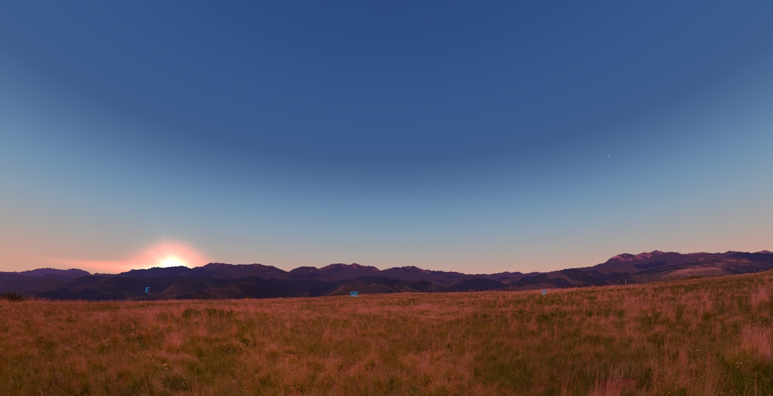
March 15
8 a.m.
E SE S

Slide 3
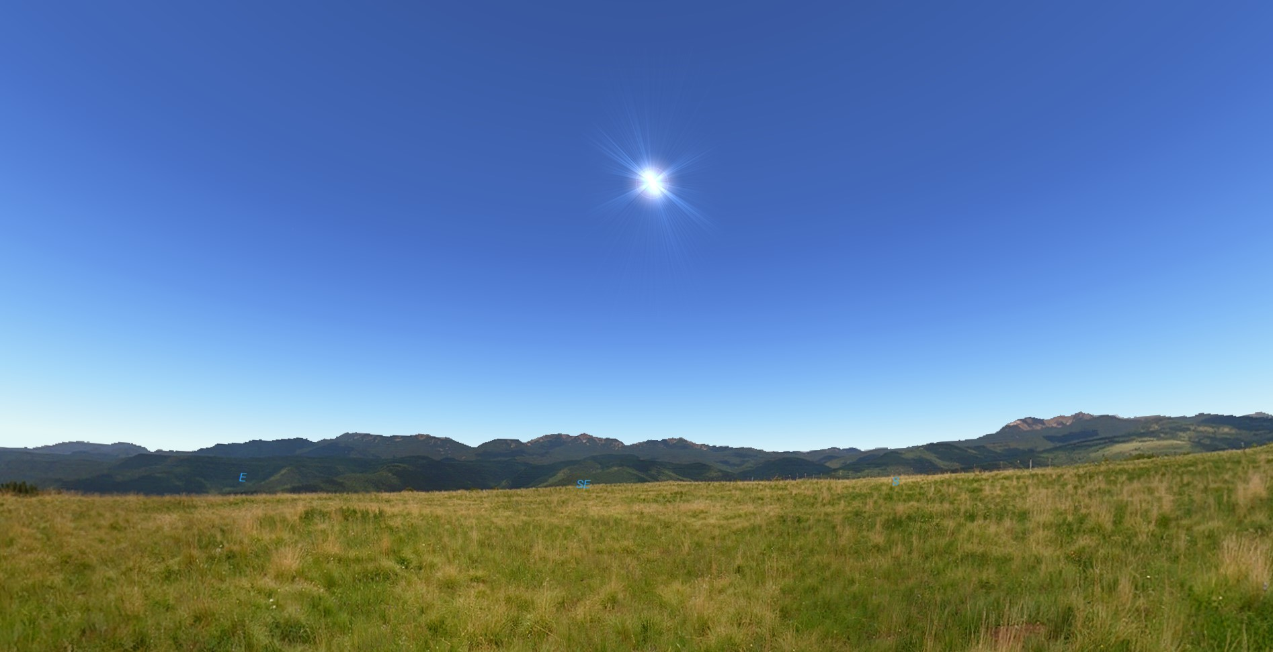
March 15
12 noon
E SE S

Slide 4
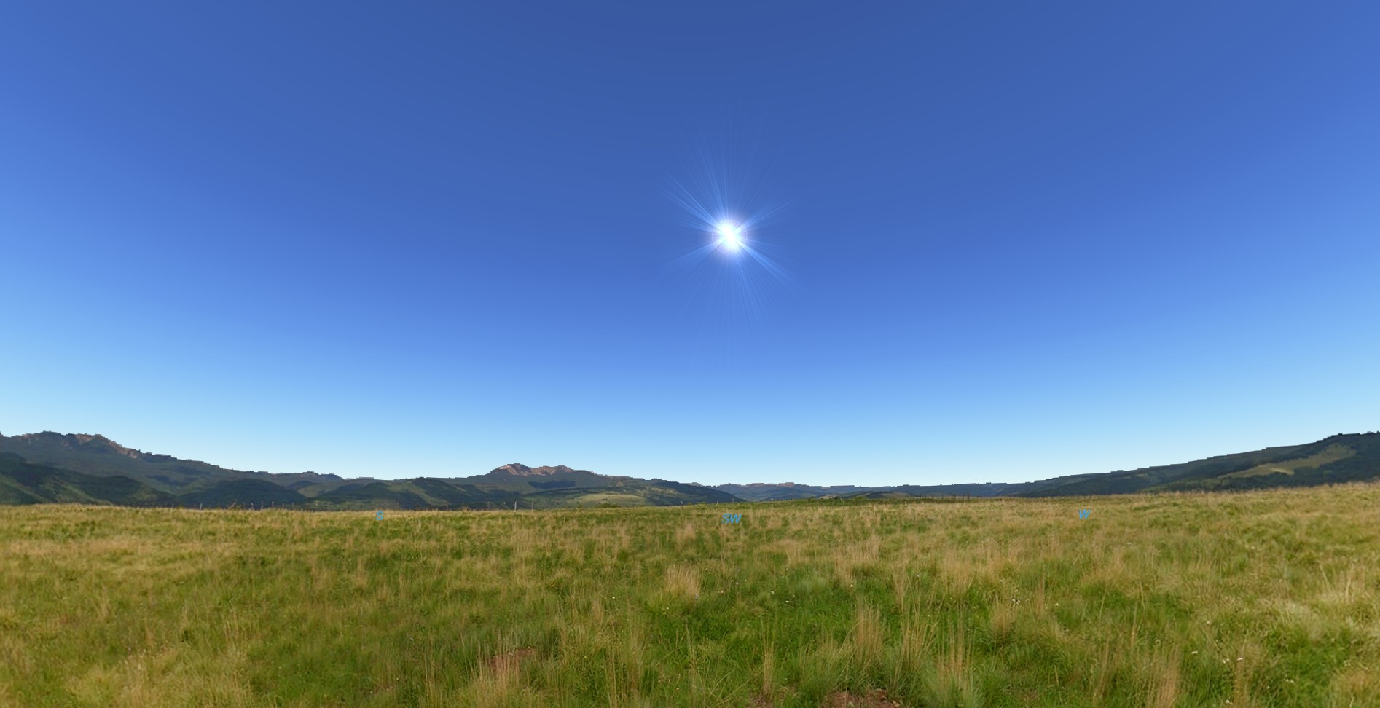
March 15
4 p.m.
S SW W

Slide 5
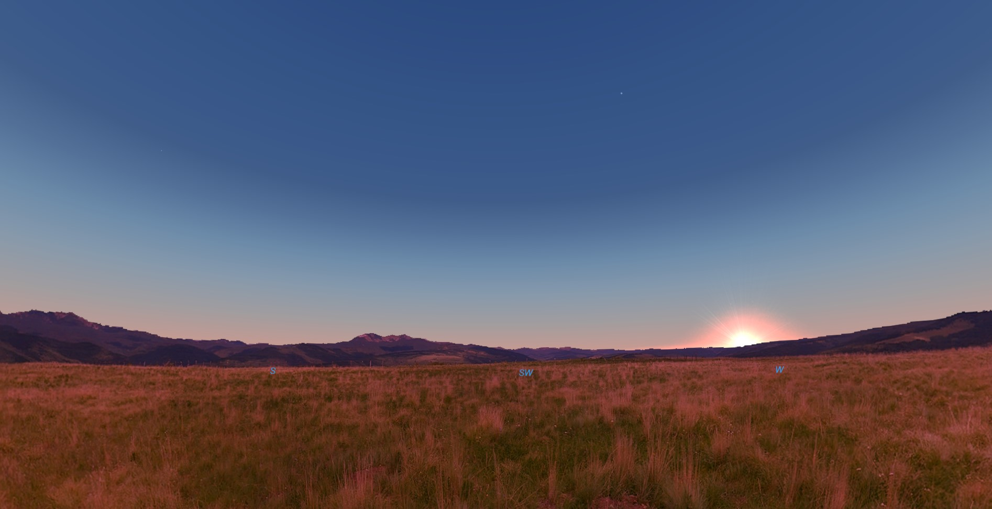
March 15
7:15 p.m.
S SW W

Slide 6
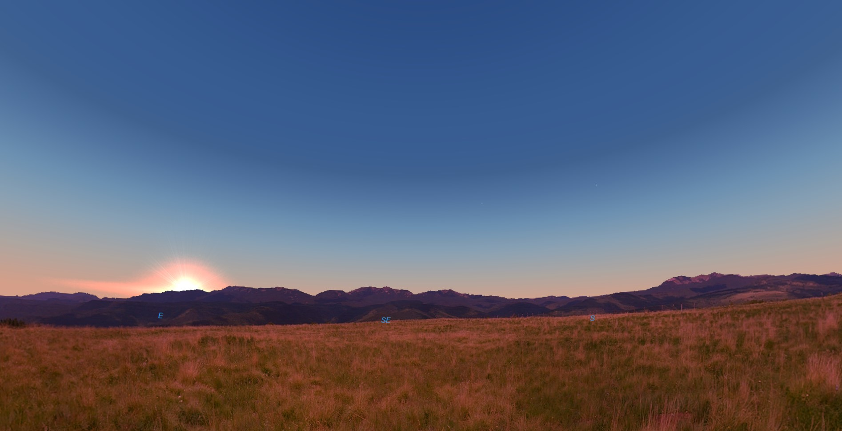
March 16
8 a.m.
E SE S

Slide 7
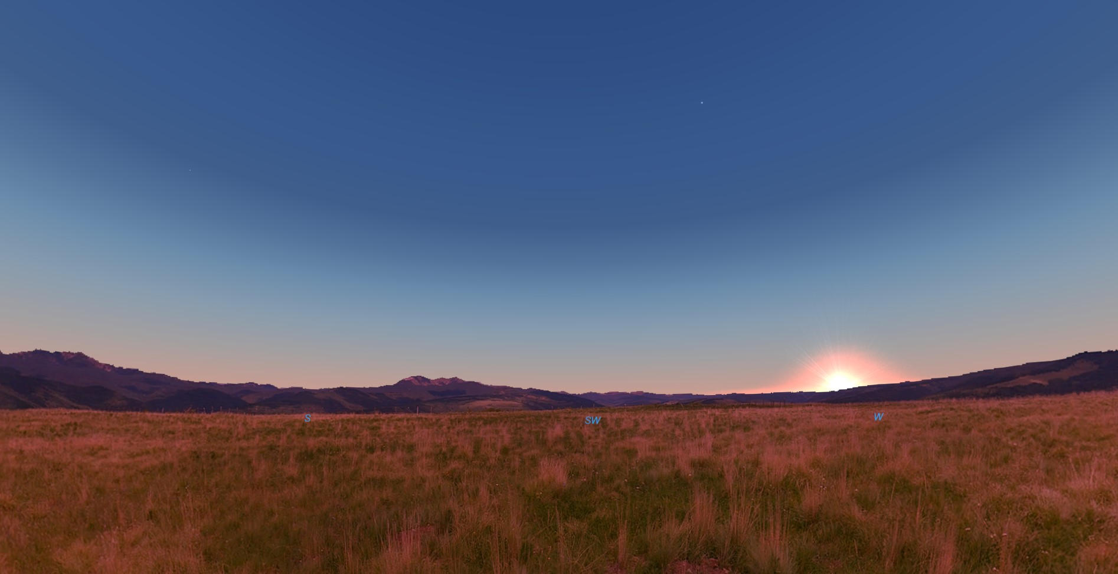
March 16
7:15 p.m.
S SW W

Slide 8
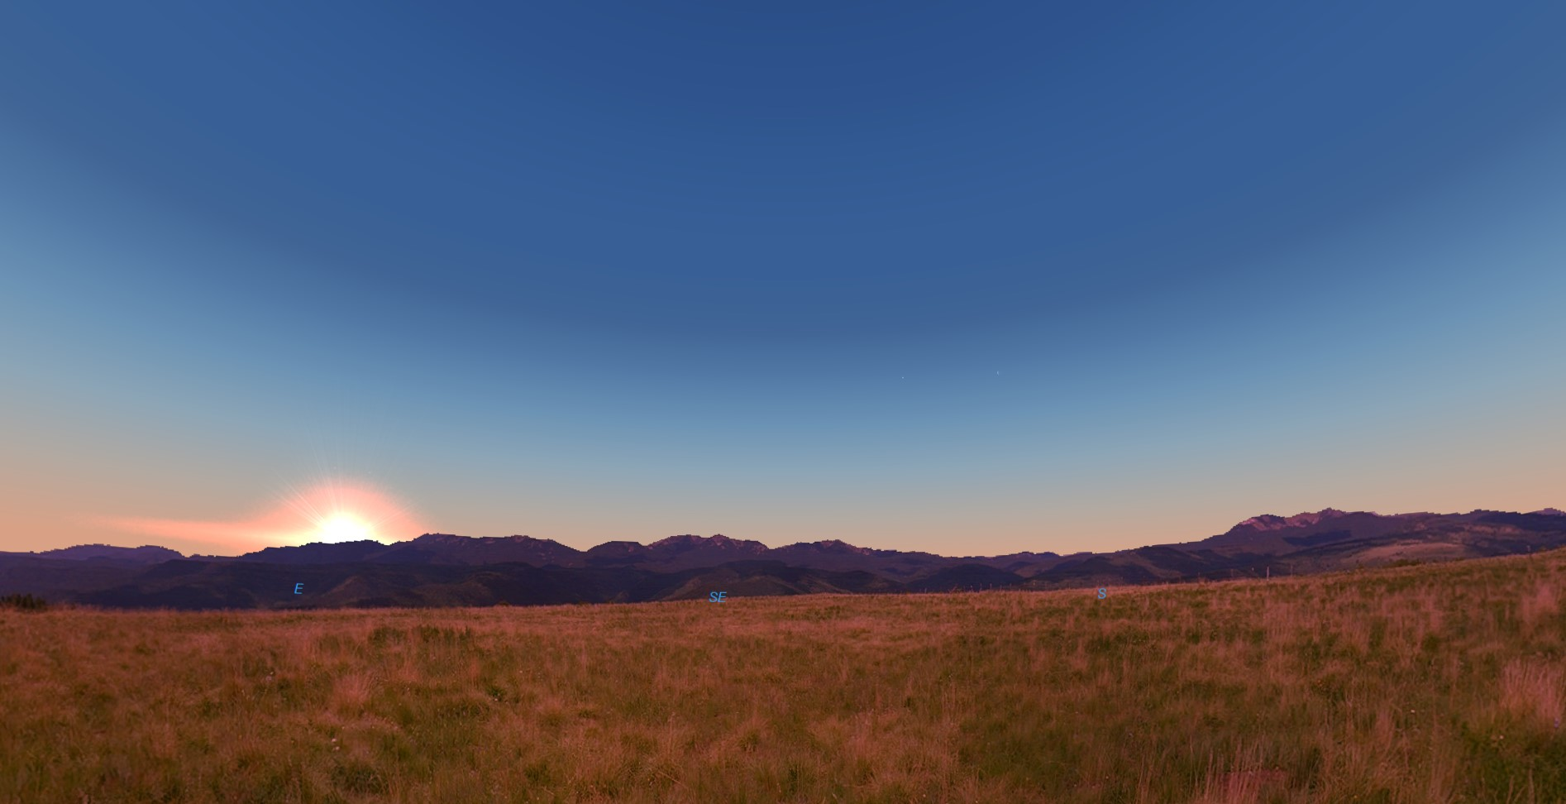
March 17
8 a.m.
E SE S

Slide 9

March 17
7:15 p.m.
S SW W

Slide 10
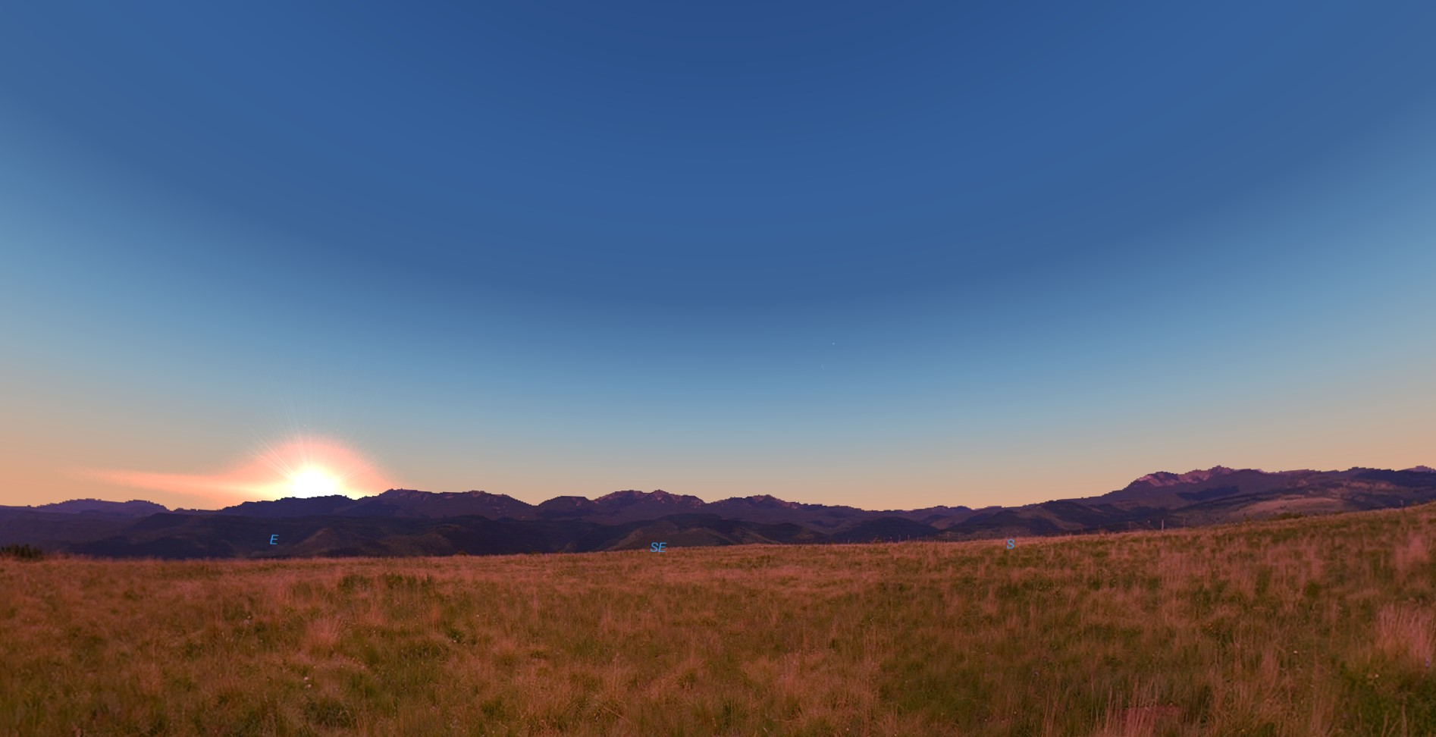
March 18
8 a.m.
E SE S

Slide 11
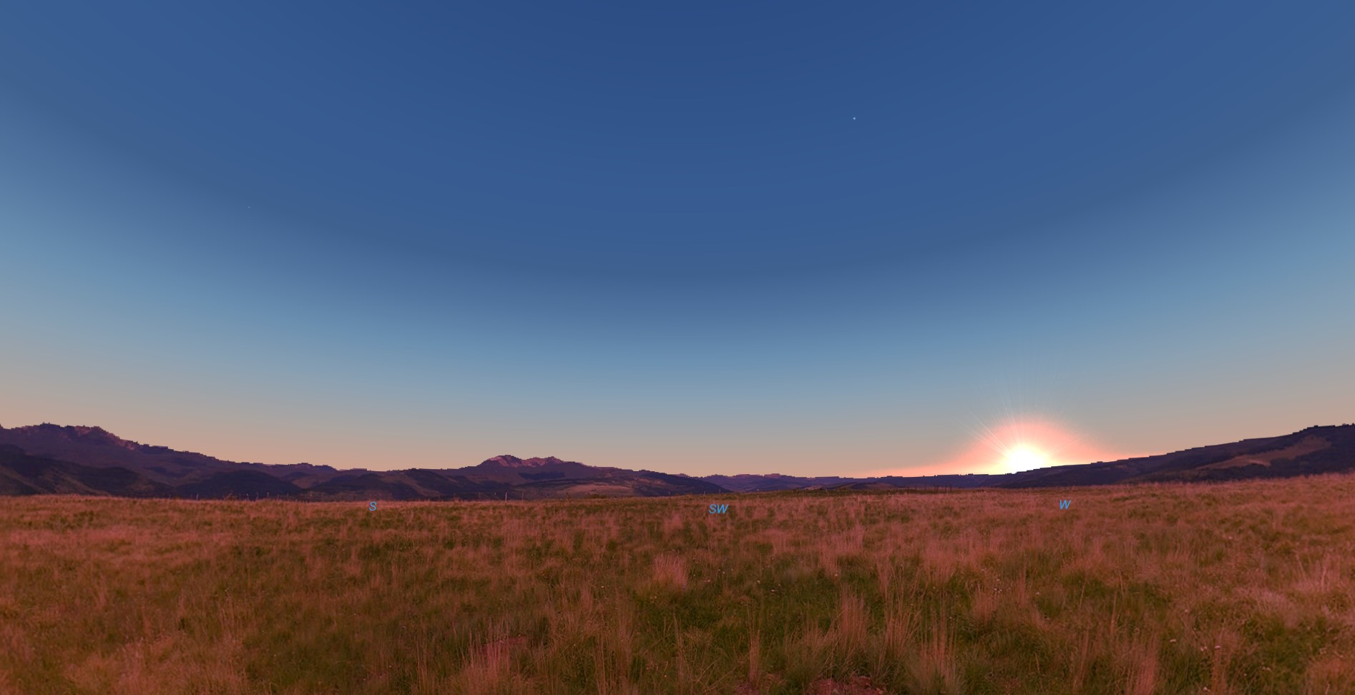
March 18
7:15 p.m.
S SW W

Slide 12

March 19
8 a.m.
E SE S

Slide 13
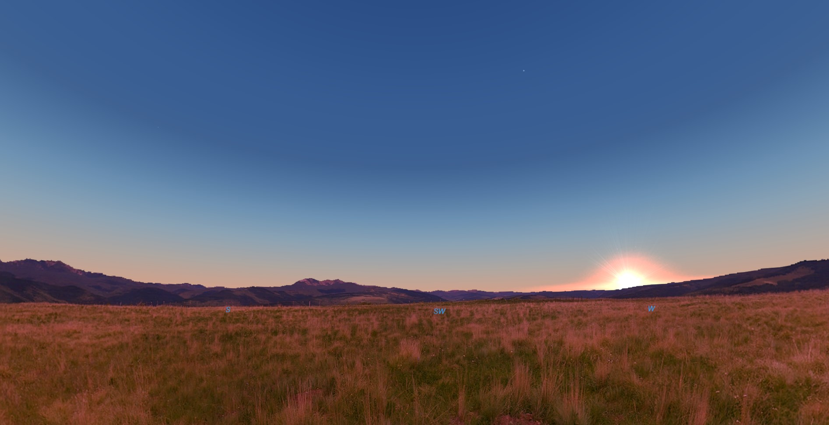
March 19
7:15 p.m.
S SW W

Slide 14
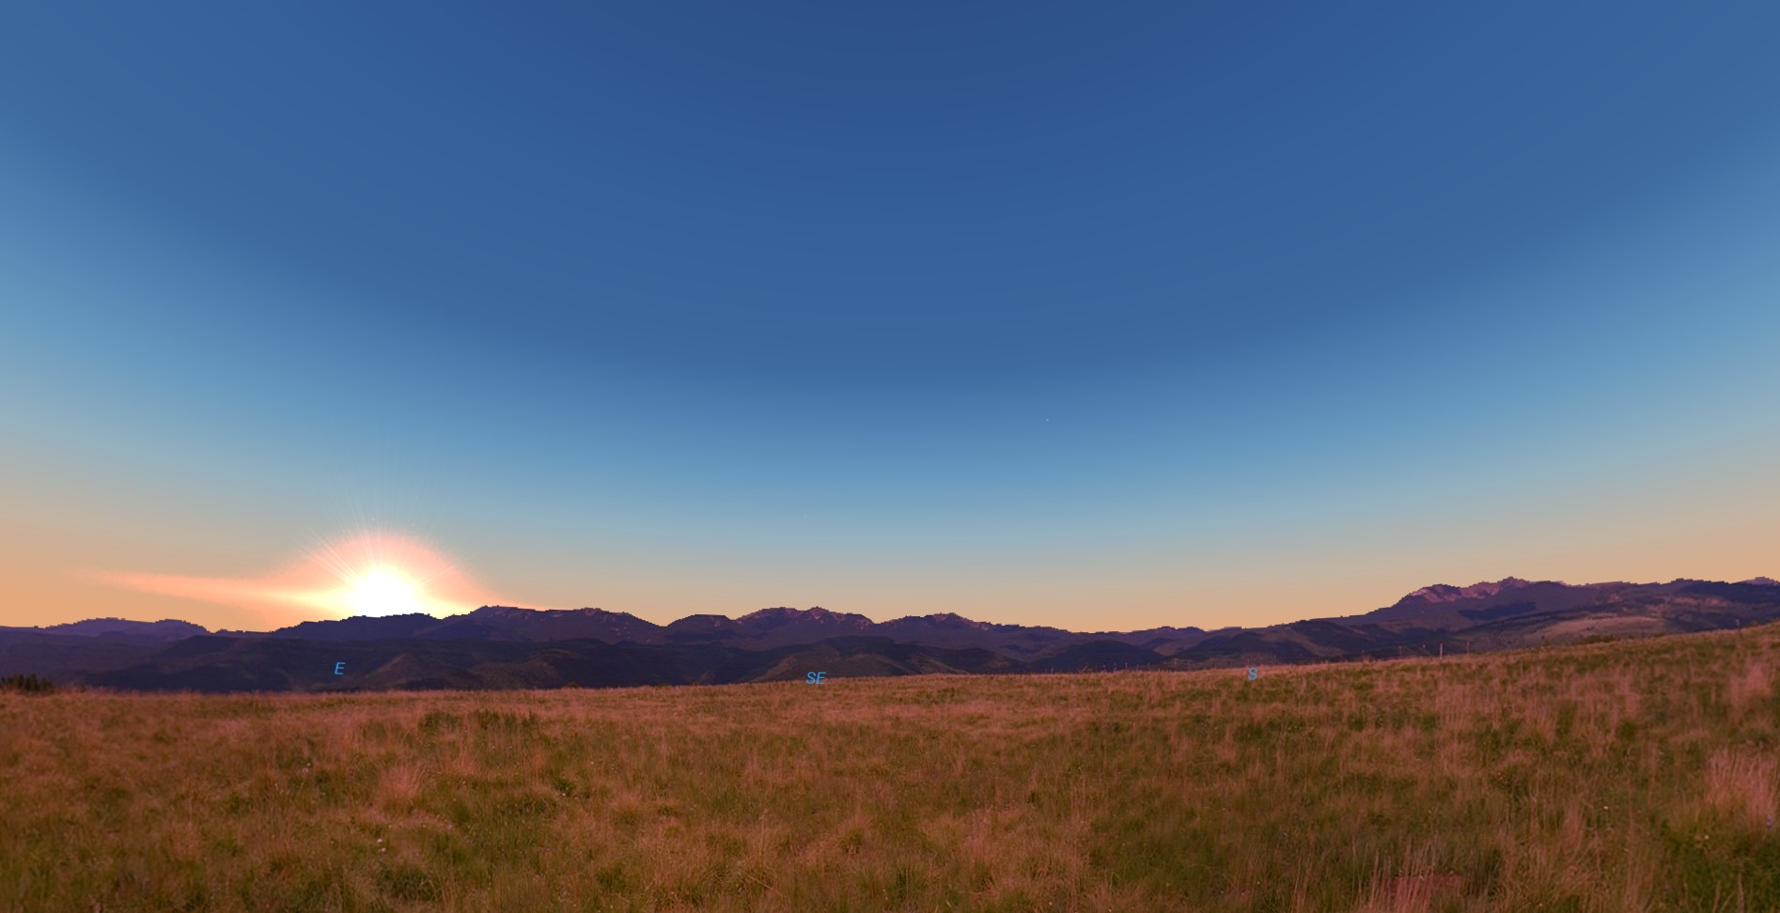
March 20
8 a.m.
E SE S

Slide 15
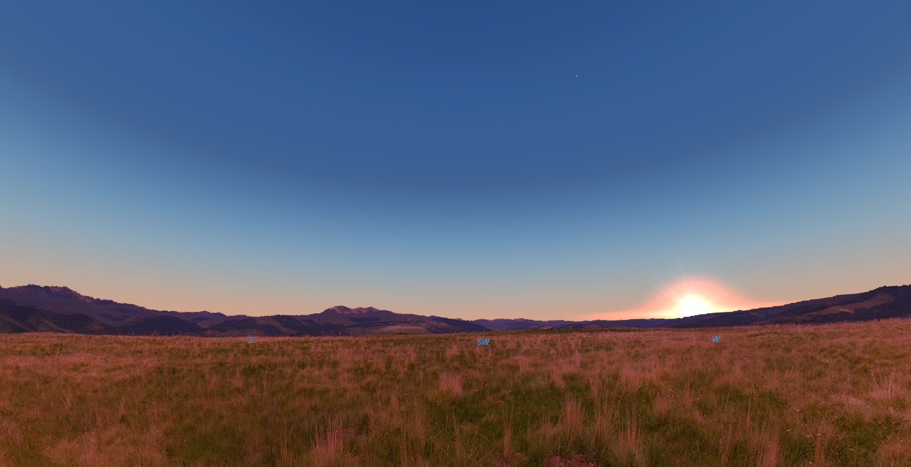
March 20
7:15 p.m.
S SW W

