Slide 1
Notes:
Engage: Can you spot the difference?
Ask students to tell you what they know about Pluto.
Ask students if they know how Pluto was first discovered.
Tell students that Pluto was discovered in 1930 by a scientist named Clyde Tombaugh. Tombaugh was comparing two images of the night sky and found an object that appeared in different places at different times. In other words, the object was moving. There were no currently known planets or asteroids in that region of space, so Tombaugh had discovered something new.
Show students the two images that Tombaugh used. Ask them if they can spot the difference? They will probably struggle to identify the difference quickly

Slide 2
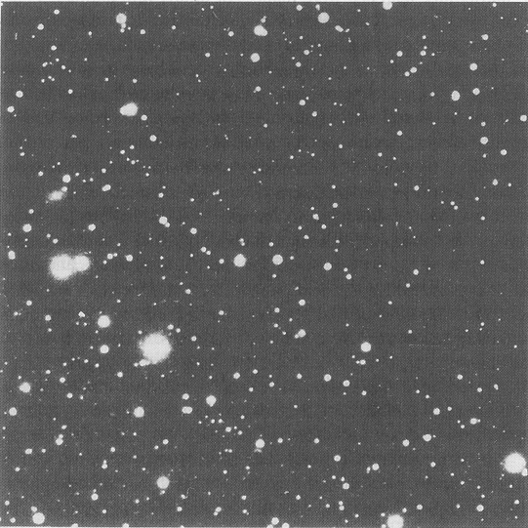
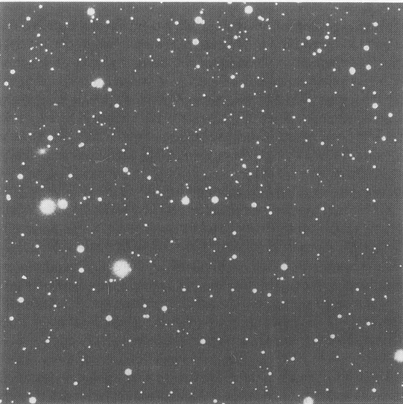
Notes:
Engage: Can you spot the difference?
Ask students to tell you what they know about Pluto.
Ask students if they know how Pluto was first discovered.
Tell students that Pluto was discovered in 1930 by a scientist named Clyde Tombaugh. Tombaugh was comparing two images of the night sky and found an object that appeared in different places at different times. In other words, the object was moving. There were no currently known planets or asteroids in that region of space, so Tombaugh had discovered something new.
Show students the two images that Tombaugh used. Ask them if they can spot the difference? They will probably struggle to identify the difference quickly

Slide 3
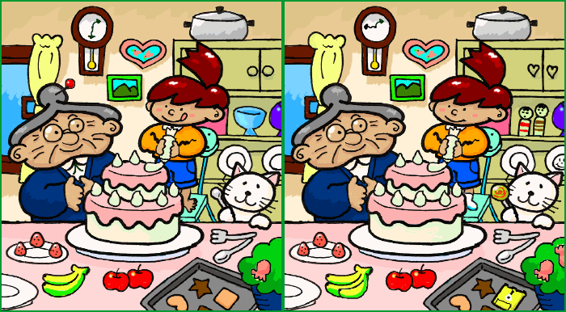
Notes:
Explore: Can you spot the difference? Pt 2.
Tell students that they could use some practice finding differences in an easier image, then they can try to find Pluto again. Show students the simpler “find the difference” images.
Give students several minutes to spot differences. Some may get spotted quickly and some may take more time.
Stop students before they can fully finish and tell them that there is a simpler way to find the differences. When scientists are trying to answer a question, they want to find the simplest, effective way to find the answer.
Show students the first “find the difference” image that has been split. Then show students the second image.
Quickly switch back to the first image. Then back to the second image. Repeat several times. As you flip back and forth, the differences in the images should become easy to observe.

Slide 4
Notes:
Explore: Can you spot the difference? Pt 2.
Tell students that they could use some practice finding differences in an easier image, then they can try to find Pluto again. Show students the simpler “find the difference” images.
Give students several minutes to spot differences. Some may get spotted quickly and some may take more time.
Stop students before they can fully finish and tell them that there is a simpler way to find the differences. When scientists are trying to answer a question, they want to find the simplest, effective way to find the answer.
Show students the first “find the difference” image that has been split. Then show students the second image.
Quickly switch back to the first image. Then back to the second image. Repeat several times. As you flip back and forth, the differences in the images should become easy to observe.

Slide 5
Notes:
Explain
Ask students which method was more useful to spot differences: side by side or switching.
Tell students that the switching back and forth technique is called a “blink comparator”. The display “blinks” each image, allowing an observer to compare the differences.
Ask students to explain how the blink comparator method works and why it is useful.

Slide 6
Notes:
Elaborate
Tell students that they can use this new technique with the photos that include Pluto.
Blink back and forth between the two Pluto images, giving students time to find Pluto. Students may need to approach the projector screen to demonstrate what they see.
Once Pluto has been identified, blink back and forth between the slides with the labelled arrows.
Tell students that this method is much faster – but discovering Pluto in 1930 was still not easy!
Previous scientists had calculated where an unknown planet might be in the sky, but a large section of the sky had to be photographed. Each photograph required about an hour to develop, meaning only a few photographs could be obtained each night. And not all night are good conditions for stargazing – clouds, full moon, and the time of year can block parts of the sky.
Clyde Tombaugh had to blink compare hundreds of images to find Pluto. And early photographic techniques were not as easy as those today. Each set of photographs were actually large 14” by 17” glass plates, instead of the digital photographs used today.

Slide 7
Notes:
Elaborate
Tell students that they can use this new technique with the photos that include Pluto.
Blink back and forth between the two Pluto images, giving students time to find Pluto. Students may need to approach the projector screen to demonstrate what they see.
Once Pluto has been identified, blink back and forth between the slides with the labelled arrows.
Tell students that this method is much faster – but discovering Pluto in 1930 was still not easy!
Previous scientists had calculated where an unknown planet might be in the sky, but a large section of the sky had to be photographed. Each photograph required about an hour to develop, meaning only a few photographs could be obtained each night. And not all night are good conditions for stargazing – clouds, full moon, and the time of year can block parts of the sky.
Clyde Tombaugh had to blink compare hundreds of images to find Pluto. And early photographic techniques were not as easy as those today. Each set of photographs were actually large 14” by 17” glass plates, instead of the digital photographs used today.

Slide 8
Notes:
Elaborate
Tell students that they can use this new technique with the photos that include Pluto.
Blink back and forth between the two Pluto images, giving students time to find Pluto. Students may need to approach the projector screen to demonstrate what they see.
Once Pluto has been identified, blink back and forth between the slides with the labelled arrows.
Tell students that this method is much faster – but discovering Pluto in 1930 was still not easy!
Previous scientists had calculated where an unknown planet might be in the sky, but a large section of the sky had to be photographed. Each photograph required about an hour to develop, meaning only a few photographs could be obtained each night. And not all night are good conditions for stargazing – clouds, full moon, and the time of year can block parts of the sky.
Clyde Tombaugh had to blink compare hundreds of images to find Pluto. And early photographic techniques were not as easy as those today. Each set of photographs were actually large 14” by 17” glass plates, instead of the digital photographs used today.

Slide 10
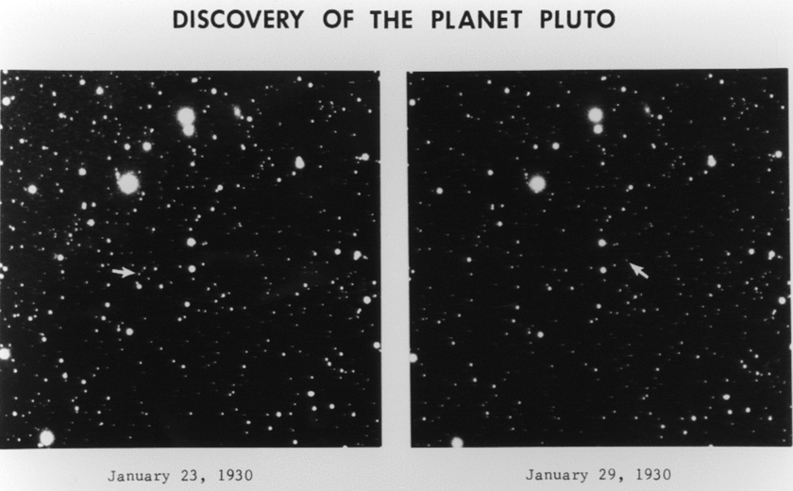
Notes:
Elaborate
Tell students that they can use this new technique with the photos that include Pluto.
Blink back and forth between the two Pluto images, giving students time to find Pluto. Students may need to approach the projector screen to demonstrate what they see.
Once Pluto has been identified, blink back and forth between the slides with the labelled arrows.
Tell students that this method is much faster – but discovering Pluto in 1930 was still not easy!
Previous scientists had calculated where an unknown planet might be in the sky, but a large section of the sky had to be photographed. Each photograph required about an hour to develop, meaning only a few photographs could be obtained each night. And not all night are good conditions for stargazing – clouds, full moon, and the time of year can block parts of the sky.
Clyde Tombaugh had to blink compare hundreds of images to find Pluto. And early photographic techniques were not as easy as those today. Each set of photographs were actually large 14” by 17” glass plates, instead of the digital photographs used today.

Slide 11
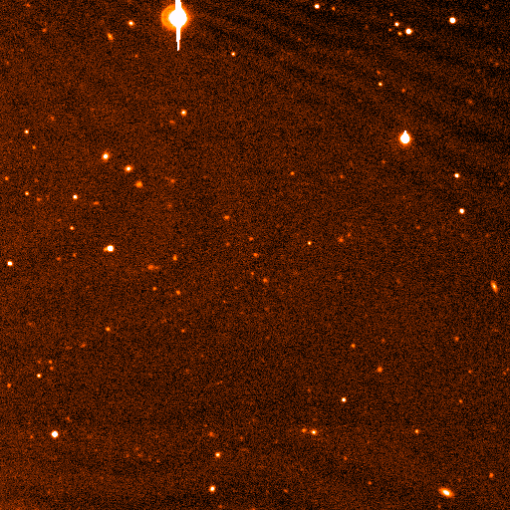
Notes:
Evaluate
Tell students you have one more astronomical object for them to identify using a blink comparator.
Show students the next two slides, using the blink comparator method.
Give students time to identify the moving object.
Ask students if there is anything different about this object. They may notice that it only moves a very small amount in the picture. This object is much farther away than Pluto – it is the dwarf planet Eris. In addition to being a slower moving object, these photos were taken closer together than the Pluto photos.
The discovery of Eris in the mid 2000s started the process that led Pluto to being reclassified as a dwarf planet. Eris was initially the “tenth planet”, but additional similar objects were also discovered. A new classification system was developed that included a “dwarf planet” category, which includes Pluto, Eris, and several other objects.

Slide 12
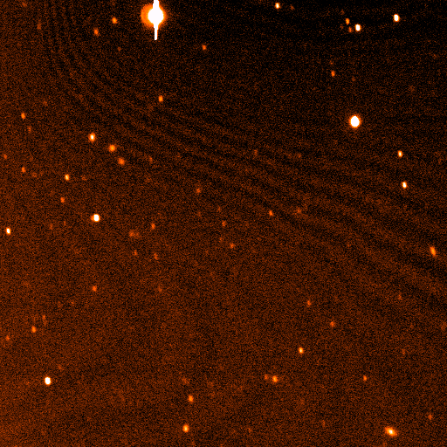
Notes:
Evaluate
Tell students you have one more astronomical object for them to identify using a blink comparator.
Show students the next two slides, using the blink comparator method.
Give students time to identify the moving object.
Ask students if there is anything different about this object. They may notice that it only moves a very small amount in the picture. This object is much farther away than Pluto – it is the dwarf planet Eris. In addition to being a slower moving object, these photos were taken closer together than the Pluto photos.
The discovery of Eris in the mid 2000s started the process that led Pluto to being reclassified as a dwarf planet. Eris was initially the “tenth planet”, but additional similar objects were also discovered. A new classification system was developed that included a “dwarf planet” category, which includes Pluto, Eris, and several other objects.

Slide 13
Notes:
Evaluate
Tell students you have one more astronomical object for them to identify using a blink comparator.
Show students the next two slides, using the blink comparator method.
Give students time to identify the moving object.
Ask students if there is anything different about this object. They may notice that it only moves a very small amount in the picture. This object is much farther away than Pluto – it is the dwarf planet Eris. In addition to being a slower moving object, these photos were taken closer together than the Pluto photos.
The discovery of Eris in the mid 2000s started the process that led Pluto to being reclassified as a dwarf planet. Eris was initially the “tenth planet”, but additional similar objects were also discovered. A new classification system was developed that included a “dwarf planet” category, which includes Pluto, Eris, and several other objects.

Slide 14
Notes:
Evaluate
Tell students you have one more astronomical object for them to identify using a blink comparator.
Show students the next two slides, using the blink comparator method.
Give students time to identify the moving object.
Ask students if there is anything different about this object. They may notice that it only moves a very small amount in the picture. This object is much farther away than Pluto – it is the dwarf planet Eris. In addition to being a slower moving object, these photos were taken closer together than the Pluto photos.
The discovery of Eris in the mid 2000s started the process that led Pluto to being reclassified as a dwarf planet. Eris was initially the “tenth planet”, but additional similar objects were also discovered. A new classification system was developed that included a “dwarf planet” category, which includes Pluto, Eris, and several other objects.

